Slide 1
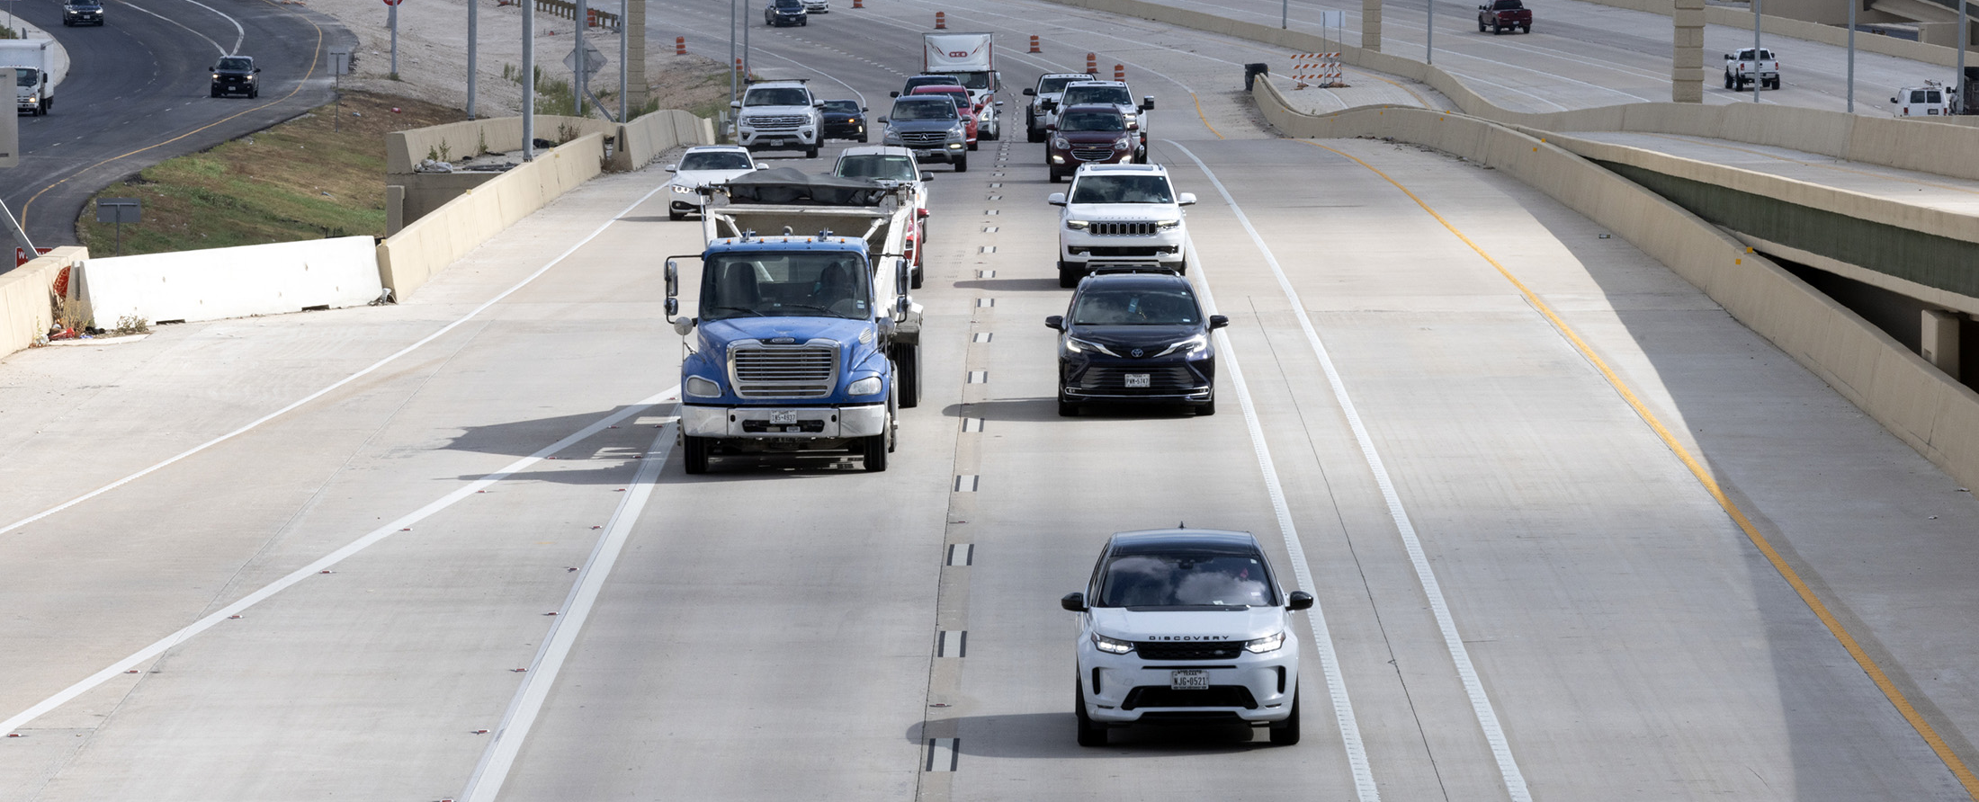
Functional Classifications

Slide 2
Table of Contents
5 | Chapter 3.3.2
6 | Interstates/Freeways/ Expressways
7 | Principal Arterials
9 | Minor Arterials
10 | Major Collectors
11 | Minor Collectors
12 | Local Roads
13 | Functional Classification System and Hierarchy
14 | TxDOT – Statewide Planning Map
15 | Resources

Slide 3

Drive like a Texan English

Slide 4

Drive like a Texan Spanish

Slide 5
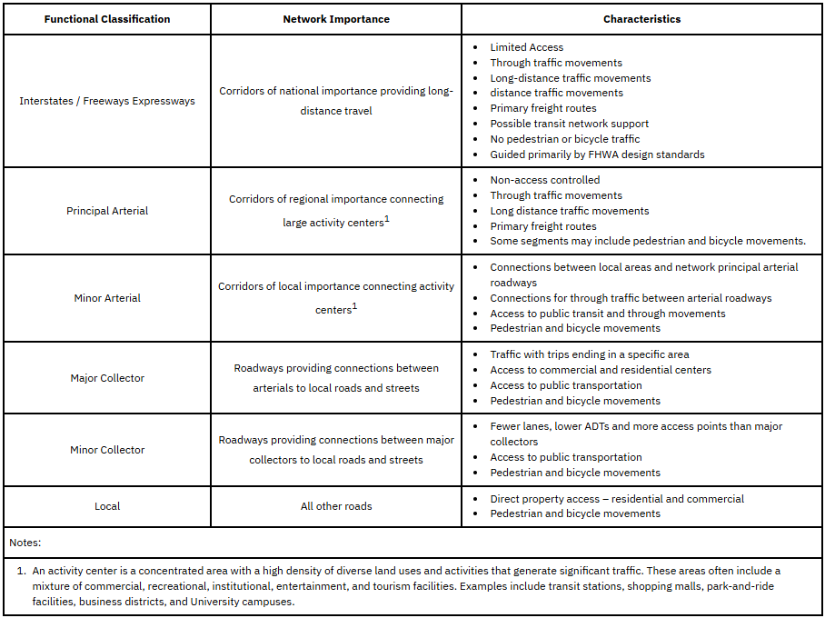
Chapter 3.3.2 Functional Classification System
There are 6 Functional Classification Types:
Interstates/Freeways/Expressways
Principal Arterials
Minor Arterials
Major Collectors
Minor Collectors
Local Roads
Table 3-1: Roadway Functional Classification System

Slide 6
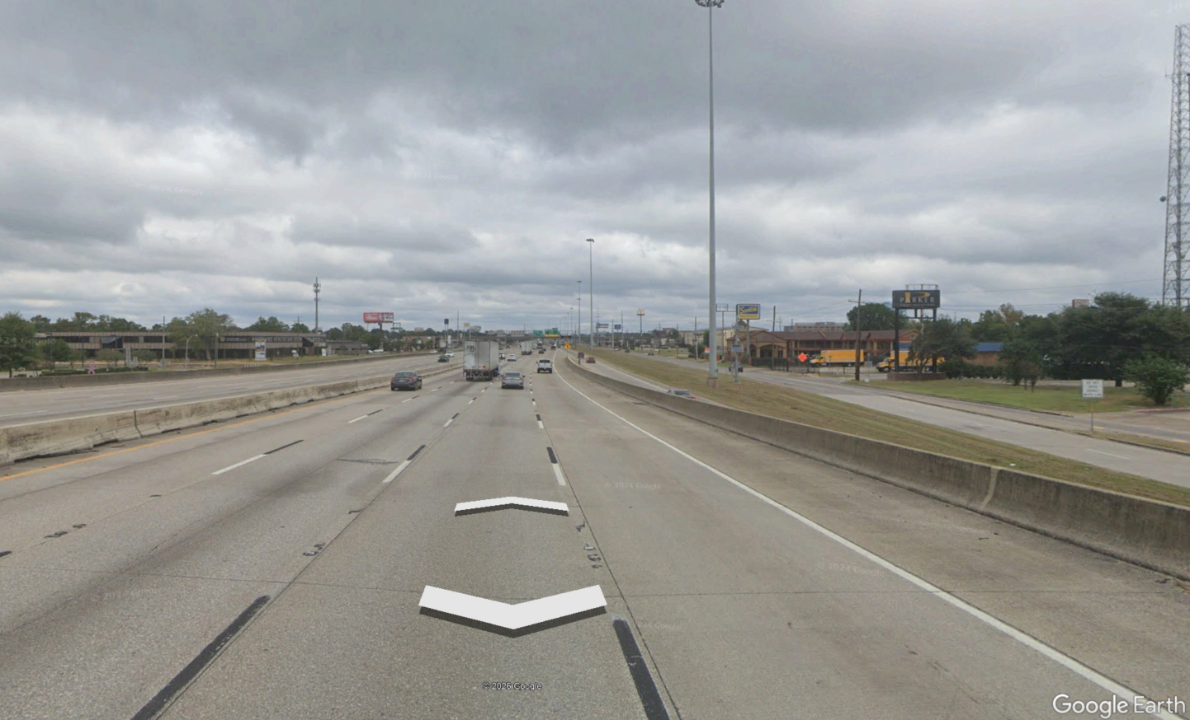
Interstates/Freeways/Expressways
Corridors or national importance providing long-distance travel characterized by:
Limited Access
Through traffic movements
Long-distance movements
Distant traffic movements
Image 1– Image of IH10 taken from Google Earth Street View (C)2026 Google

Slide 7
Interstates/Freeways/Expressways
Corridors or national importance providing long-distance travel characterized by:
Primary freight routes
Possible transit network support
No pedestrian or bicycle traffic
Guided primarily by FHWA design standards
Image 1– Image of IH10 taken from Google Earth Street View (C)2026 Google

Slide 8
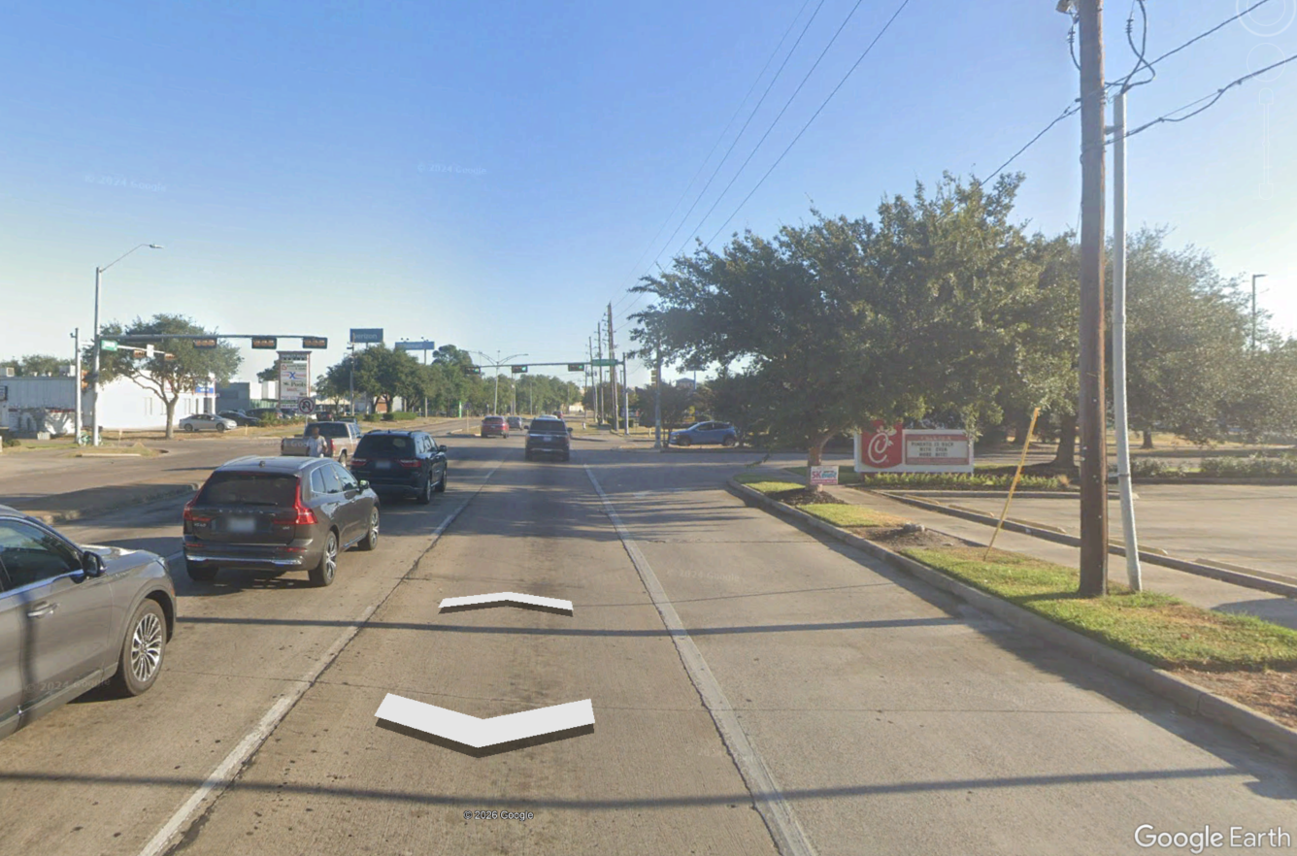
Principal Arterials
Corridors of regional importance connecting large activity centers characterized by:
Non-access controlled
Through traffic movements
Long distance traffic movements
Primary freight routes
Pedestrian/bicycle movements may be included
Image 2– Image of Dowlen Rd taken from Google Earth Street View (C)2026 Google

Slide 9
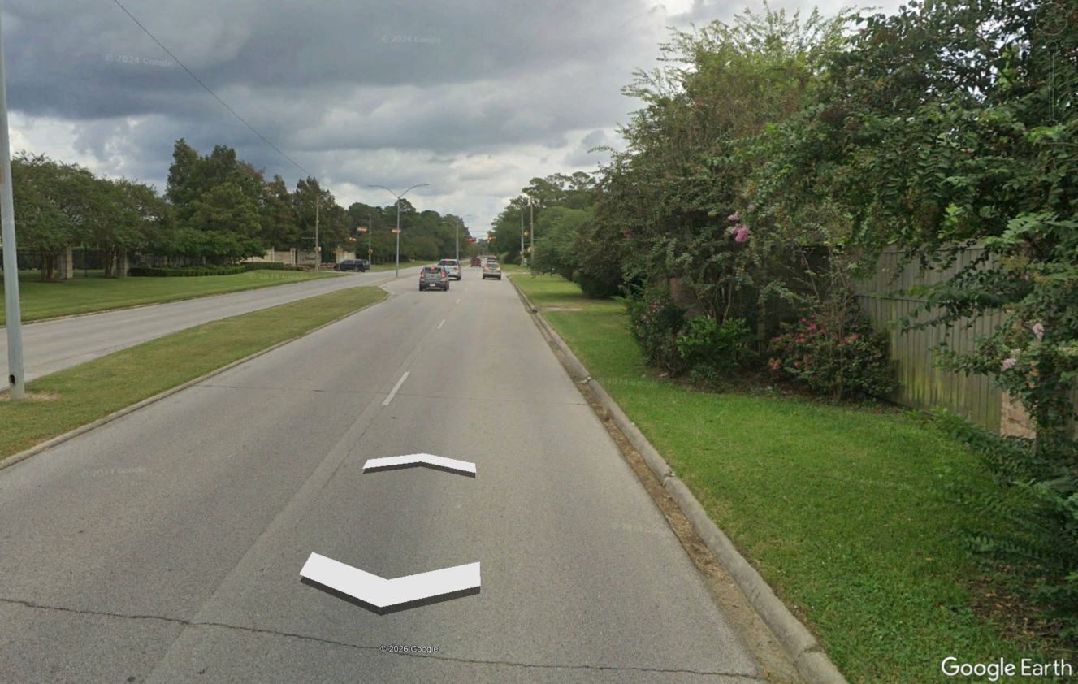
Minor Arterials
Corridors of local importance connecting large activity centers characterized by:
Connections between local areas and network principal arterial roadways
Connections for through traffic between arterial roadways
Access to public transit and through movements
Pedestrian and bicycle movements
Image 3– Image of Delaware taken from Google Earth Street View (C)2026 Google

Slide 10
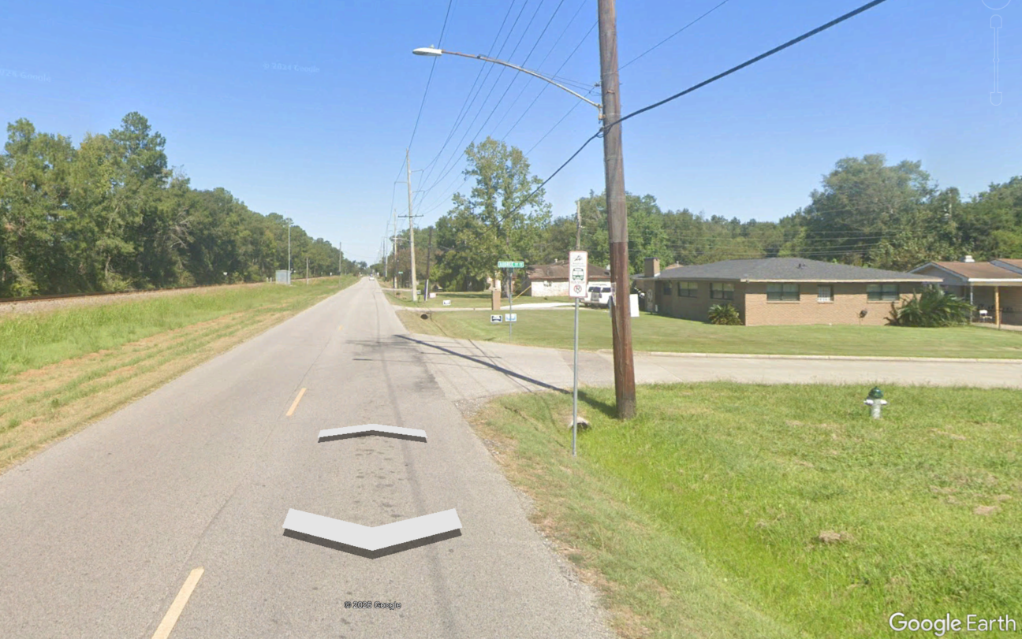
Major Collector
Roadways providing connections between arterials to local roads and streets characterized by:
Traffic with trips ending in a specific area
Access to commercial and residential centers
Access to public transportation
Pedestrian and bicycle movements
Image 4– Image of Helbig Rd taken from Google Earth Street View (C)2026 Google

Slide 11
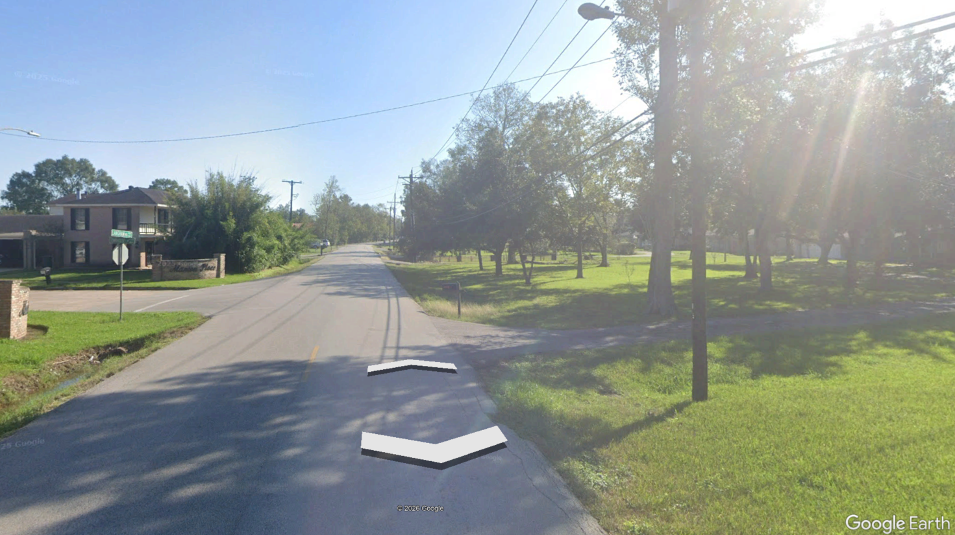
Minor Collector
Roadways providing connections between major collectors to local roads and streets characterized by:
Fewer lanes, lower ADTs and more access points than major collectors
Access to public transportation
Pedestrian and bicycle movements
Image 5– Image of Langham Rd taken from Google Earth Street View (C)2026 Google

Slide 12
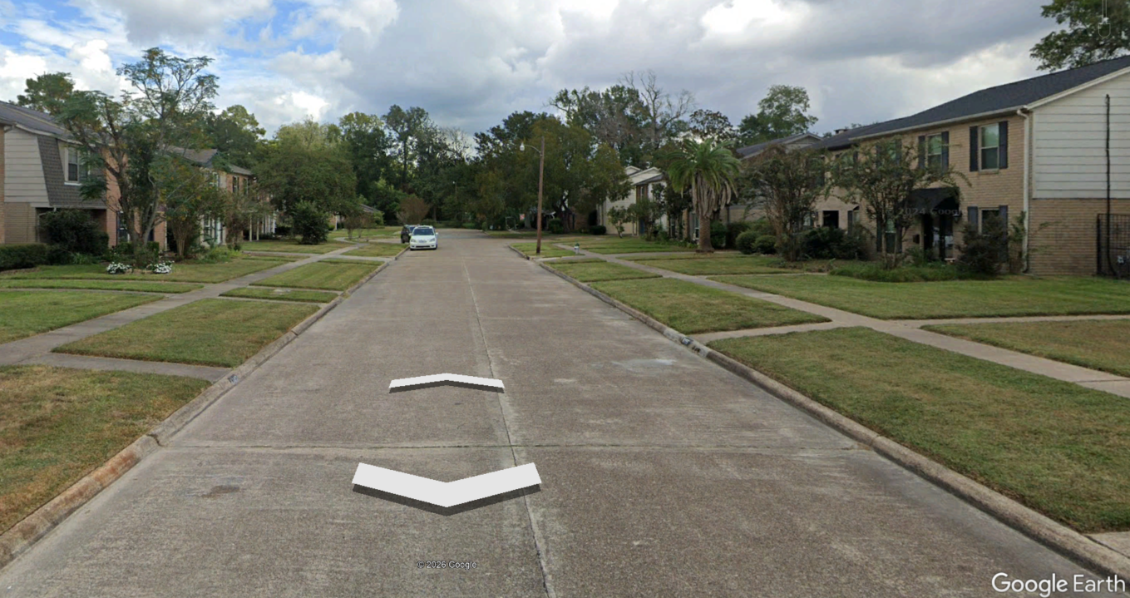
Local Roads
All other roads and streets characterized by:
Direct property access – residential and commercial
Pedestrian and bicycle movements
Image 6– Image of Afton Ln taken from Google Earth Street View (C)2026 Google

Slide 13
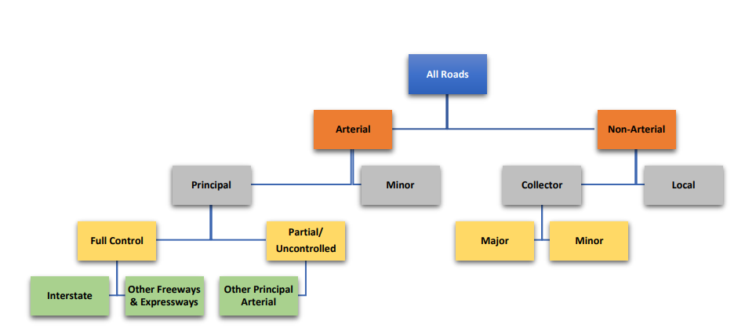
Functional Classification System and Hierarchy
Figure 3-2: Functional Classification System and Hierarchy

Slide 14
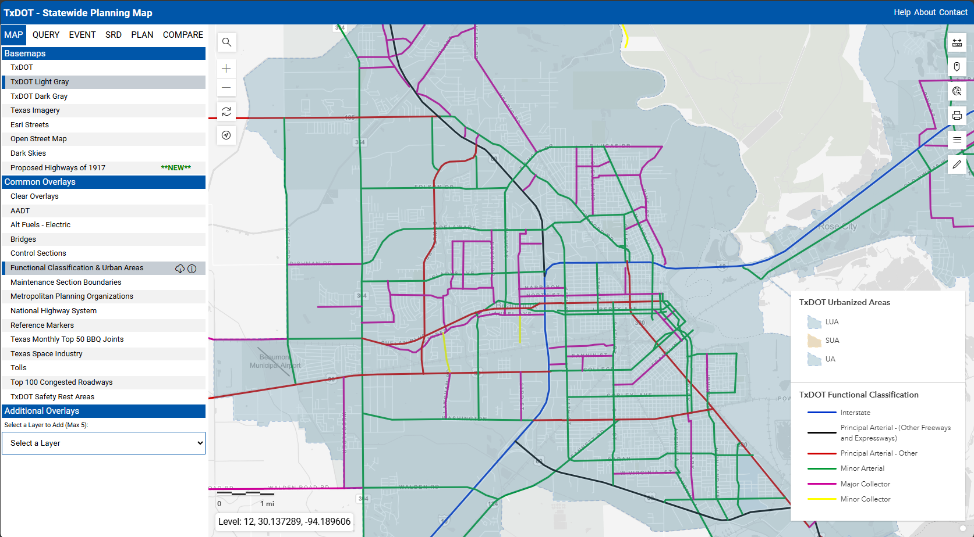
TxDOT - Statewide Planning Map

Slide 15
Resources
The TxDOT Roadway Design Manual is publicly available on TxDOT.gov
https://www.txdot.gov/manuals – link to the publicly available TxDOT Manuals
Roadway Design Manual – Chapter 3 provides information on context and facility type considerations, including Functional Classification
TxDOT - Statewide Planning Map – Has various layers providing such information as functional classification, current and future projects, AADT, speed limits, and Texas wildflowers, among others

Slide 16
Thank You
James Horne P.E. james.horne@txdot.gov
Sam Harris P.E. samantha.harris@txdot.gov
Chaitanya Desai Chaitanya.desai@txdot.gov

