Slide 1
Update from Consultant Team
October 15, 2026

Slide 2
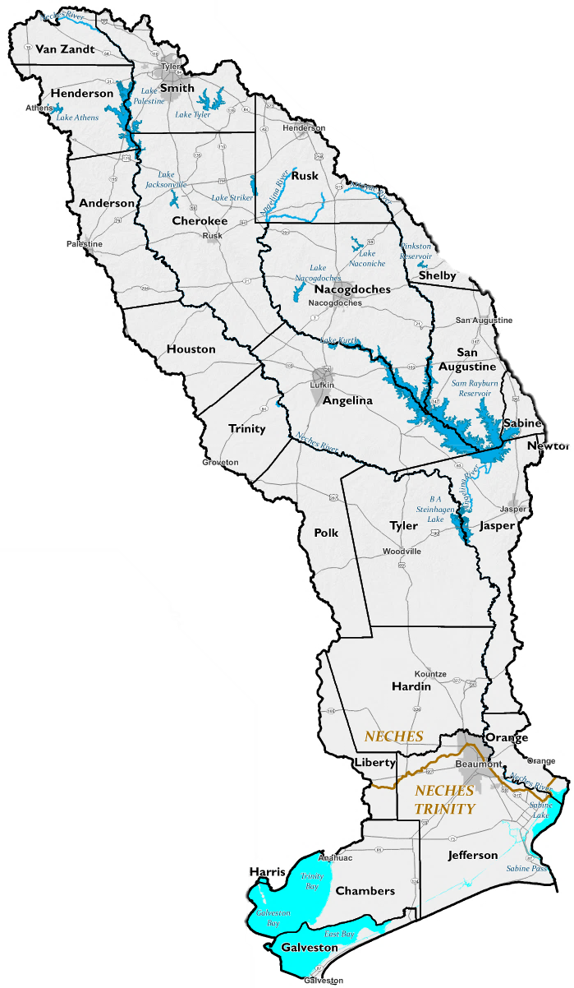
Agenda
Task 1 – Historical Storm Events
Task 4C – Performance of FMEs
Task 5A – Recommendation of FMEs, FMSs, and FMPs
Task 7 – Flood Response Information and Activities

Slide 3
Task 1 – Planning Area Description (Historical Storm Events)

Slide 4
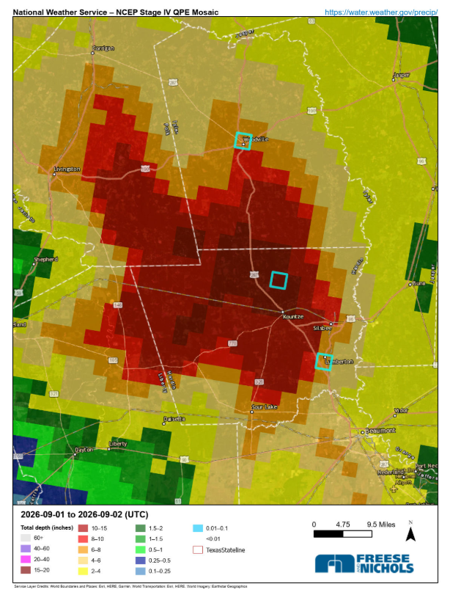
Tropical Storm Edouard
5
Woodville
Storm made landfall on September 1st and impacted several areas in SE Texas
  Hardin County
    Kountze
    Lumberton
  Polk County
    Corrigan
    Indian Springs
  Tyler County
    Woodville
Kountze
Lumberton

Slide 5
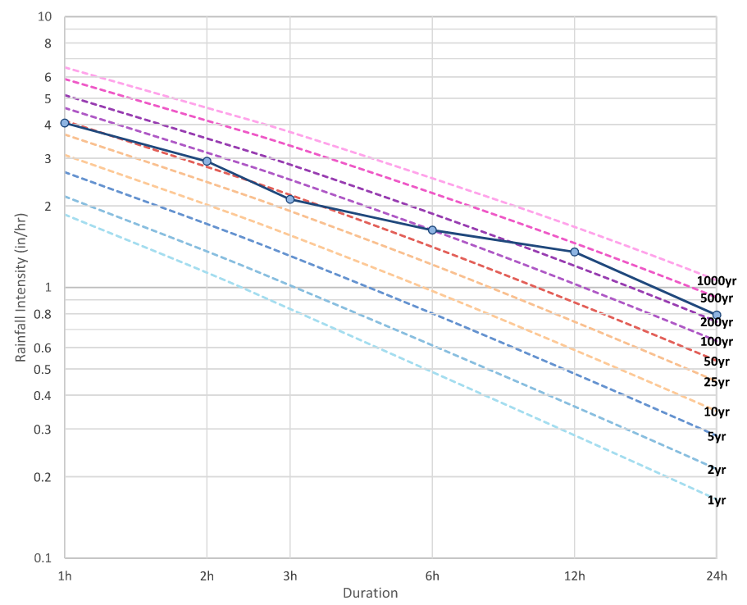
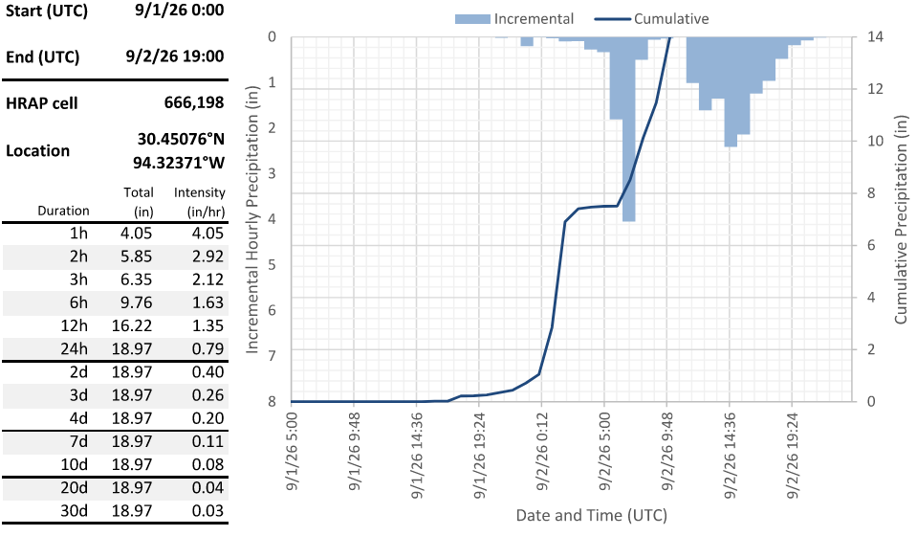
Kountze

Slide 6
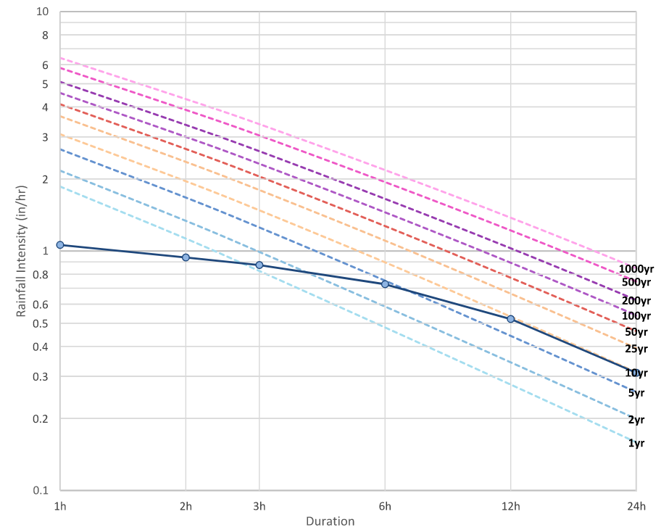
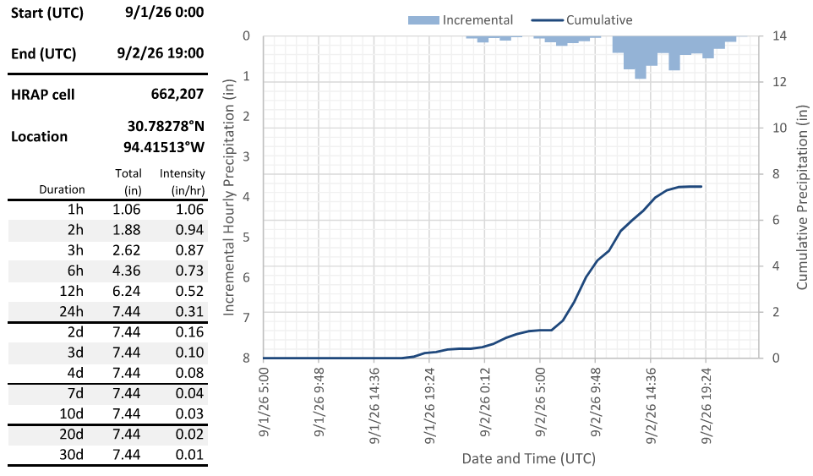
Woodville

Slide 7
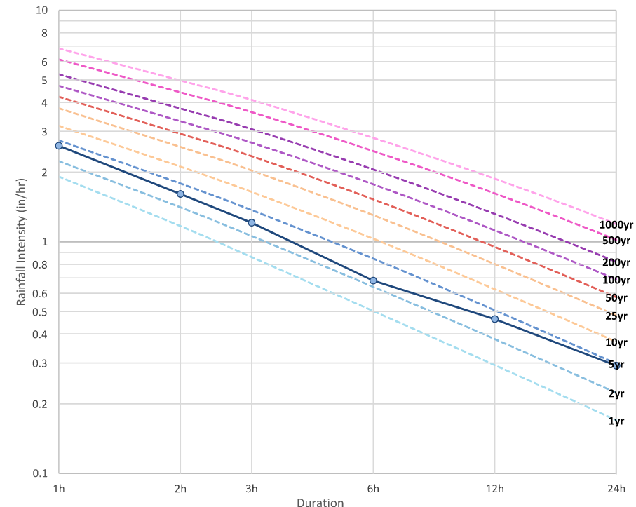
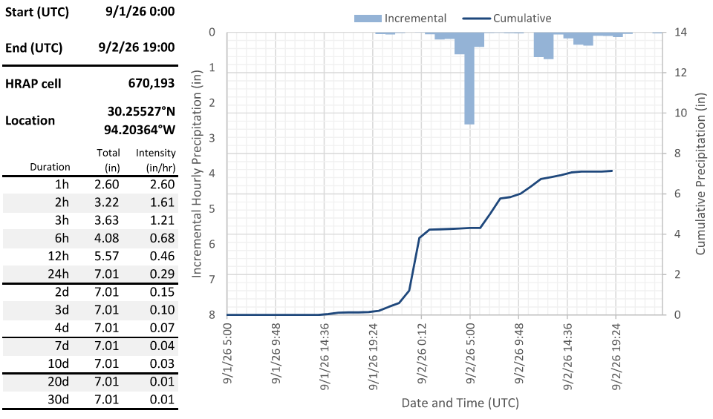
Lumberton

Slide 8
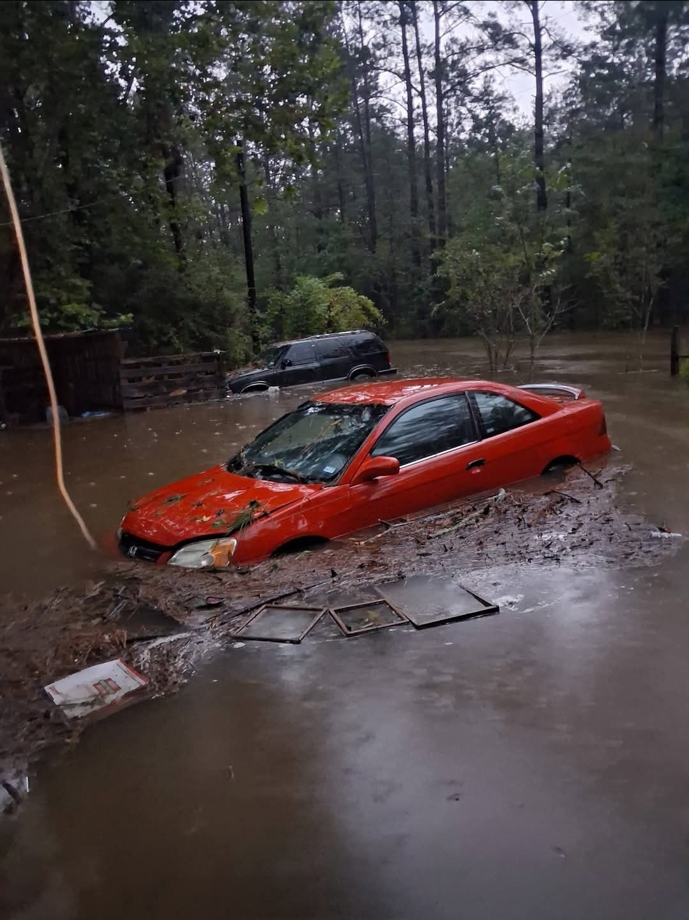
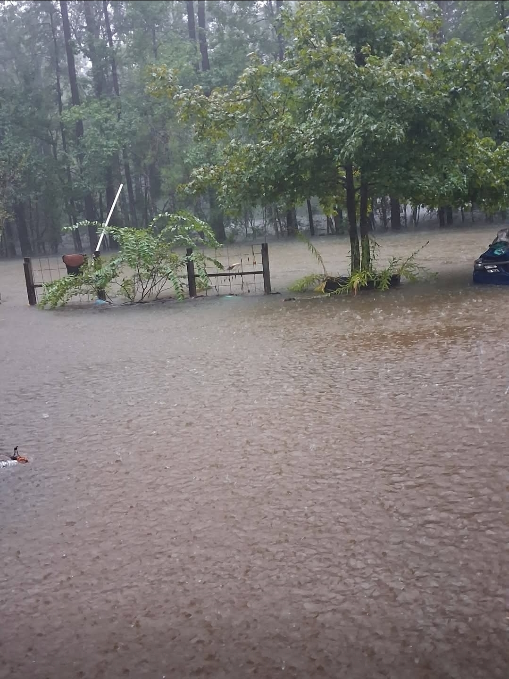
Kountze

Slide 9
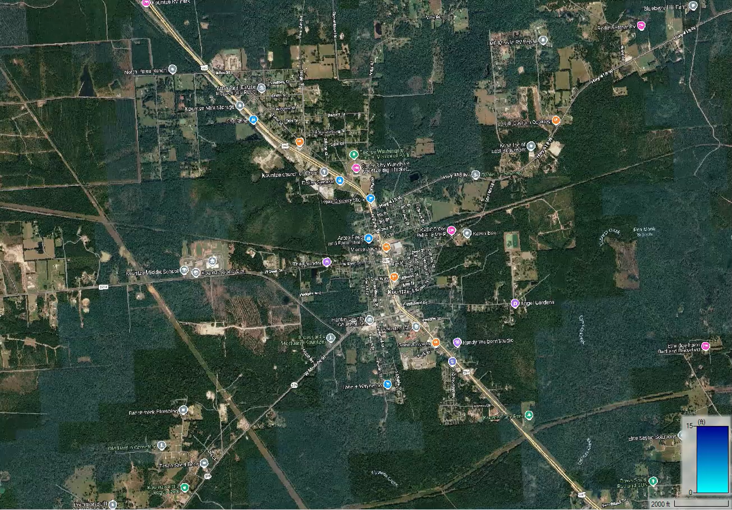

Kountze (GLO Village Creek Model)
100YR Existing Conditions
500YR Existing Conditions

Slide 10
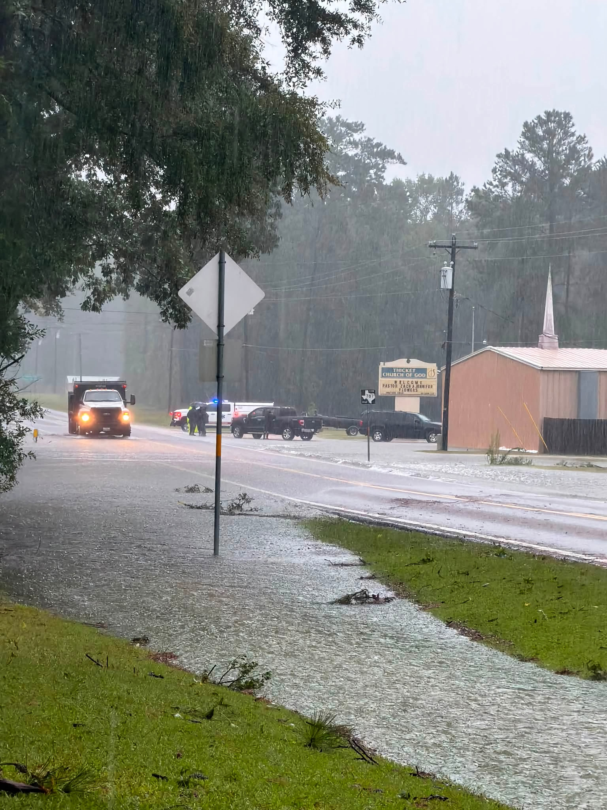
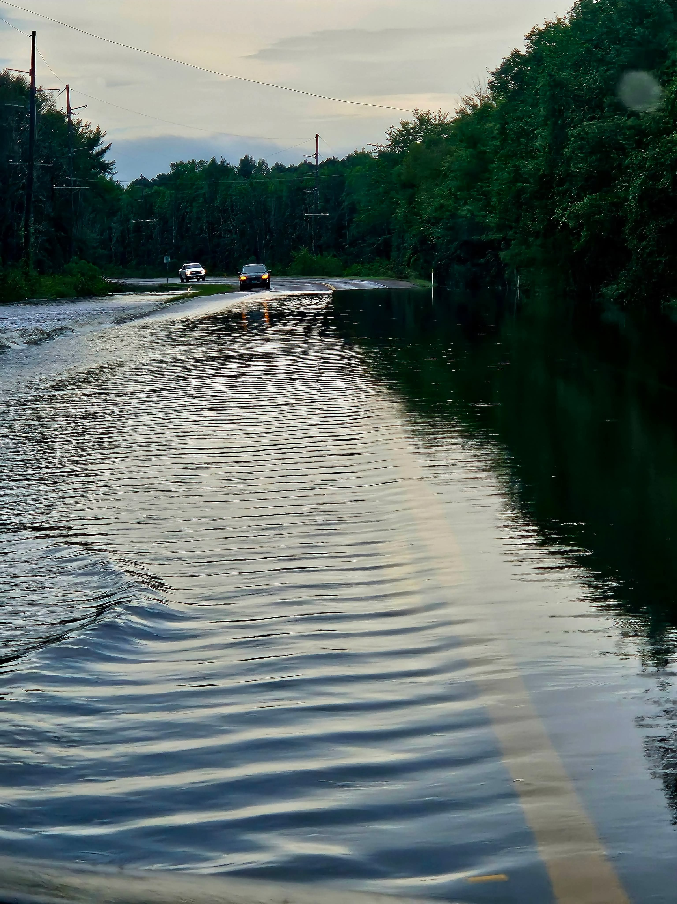
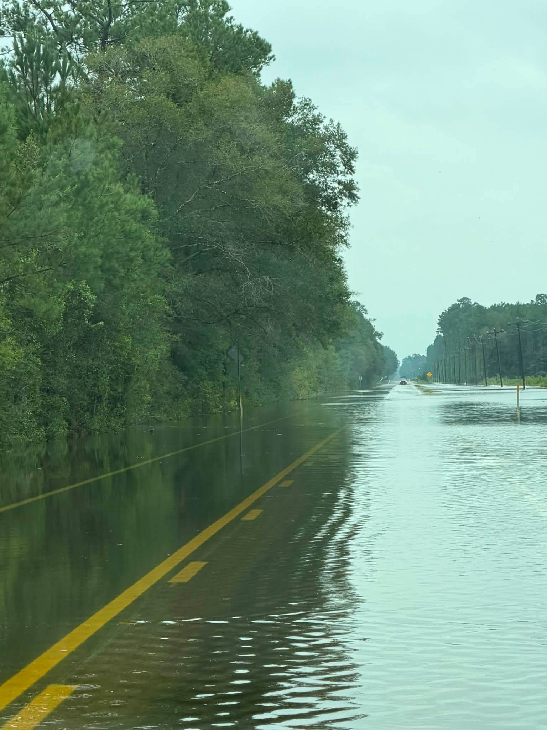
Thicket

Slide 11
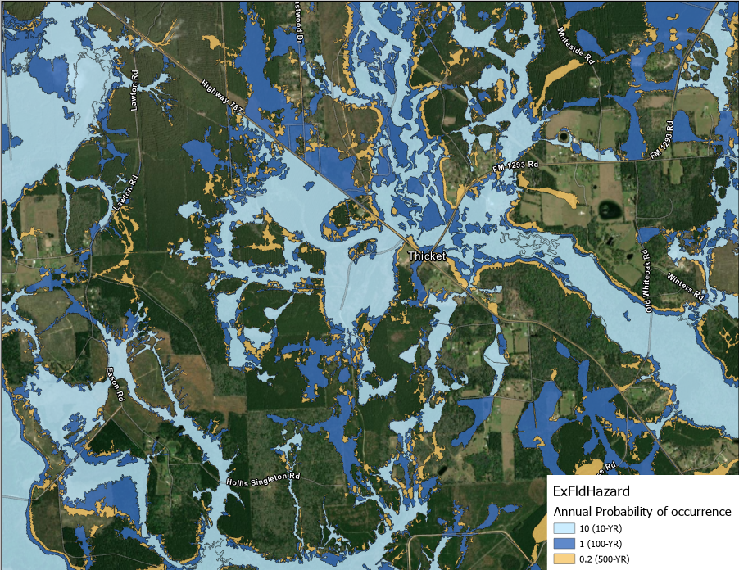
Thicket (ExFldHazard layer)

Slide 12
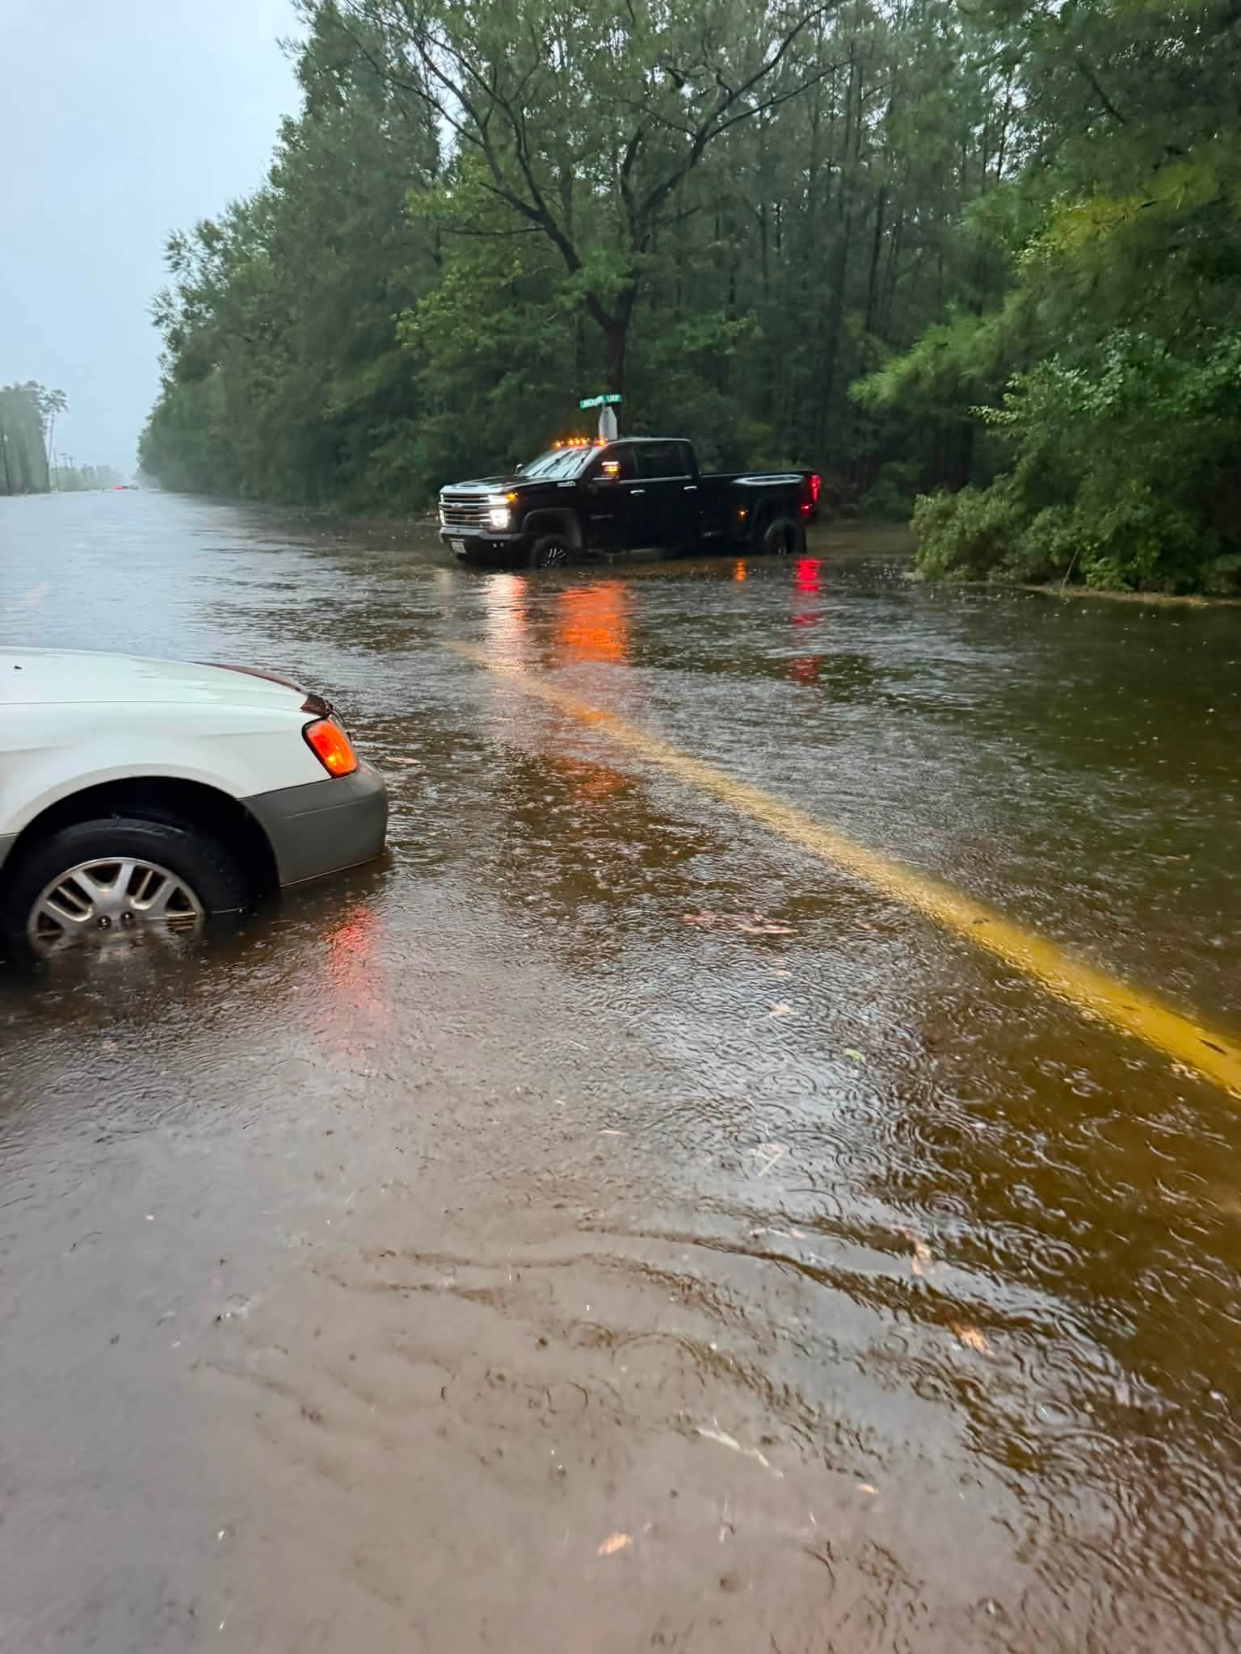
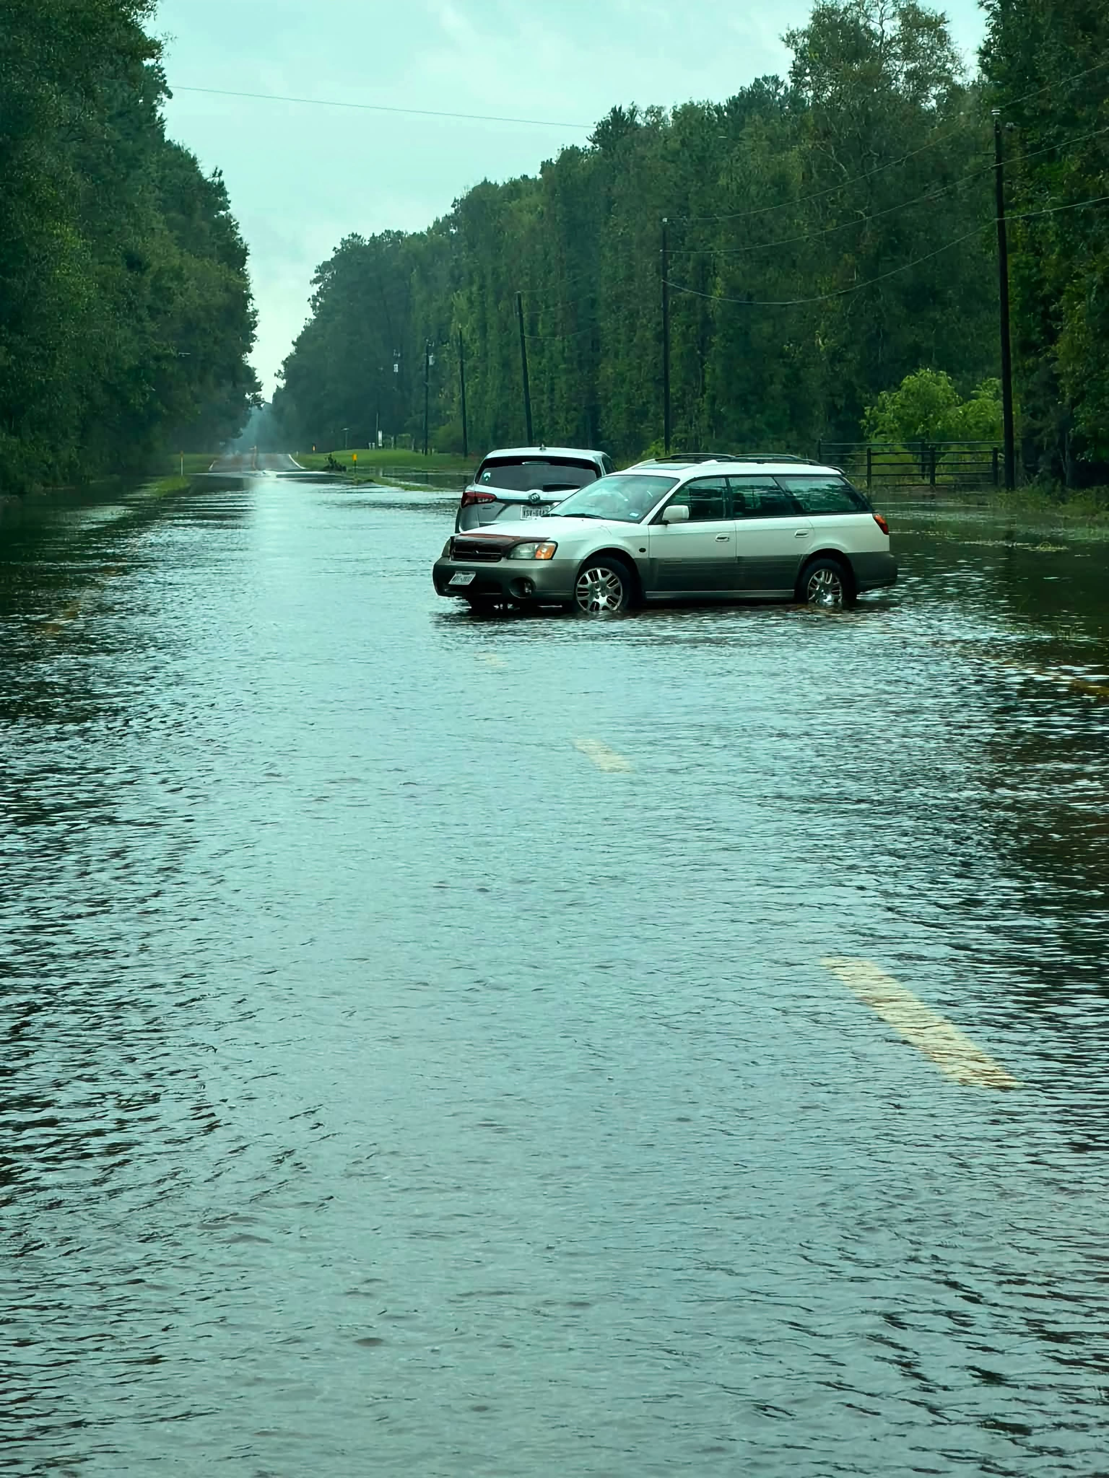
Saratoga

Slide 13
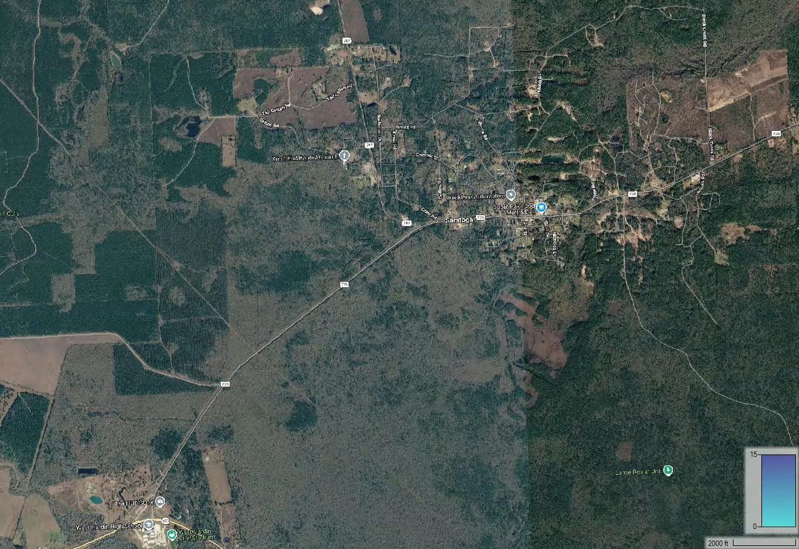
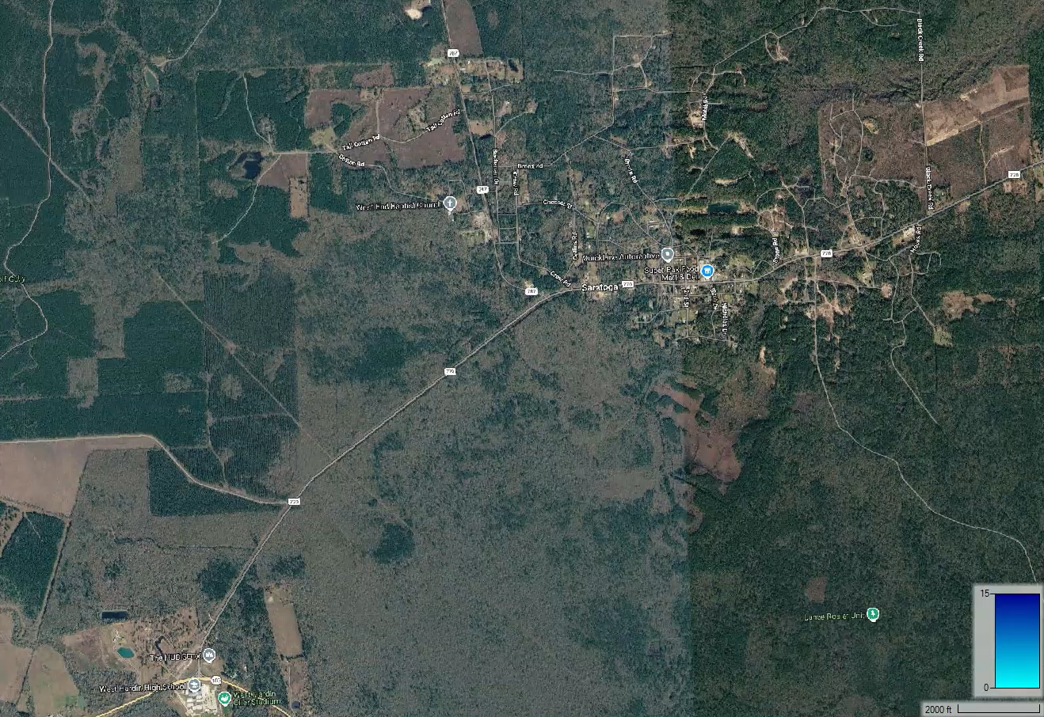
Saratoga (DD6 Model)
100YR Existing Conditions
500YR Existing Conditions
Saratoga
Saratoga

Slide 14
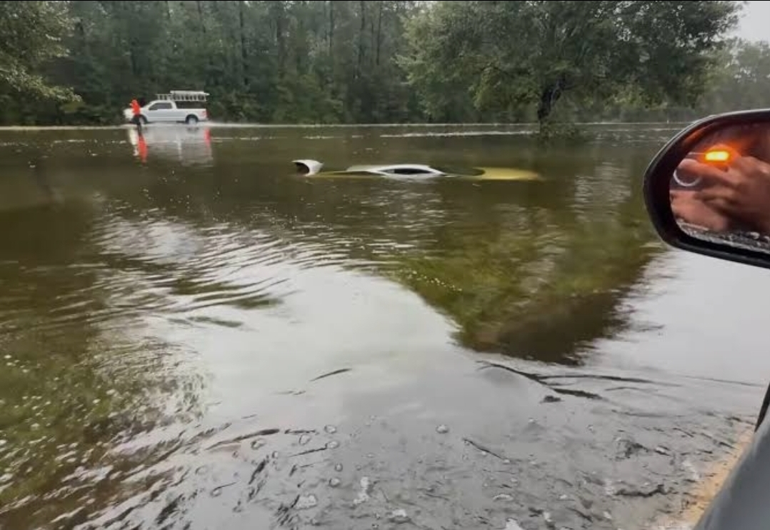
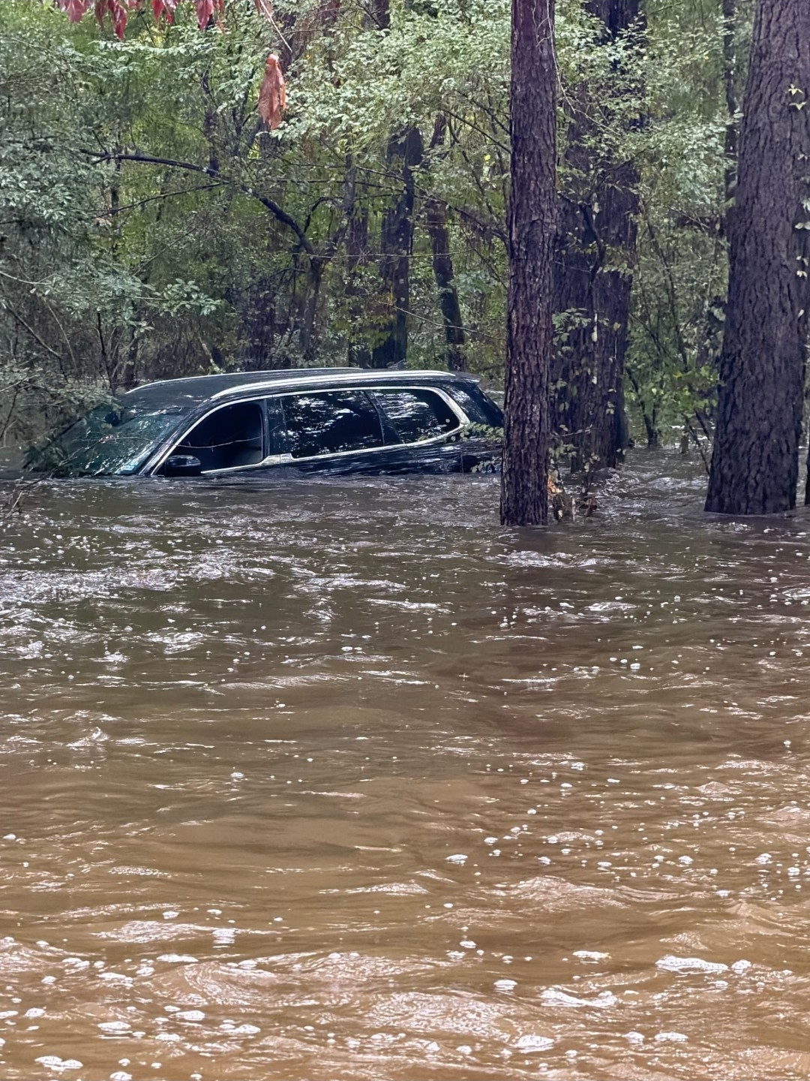
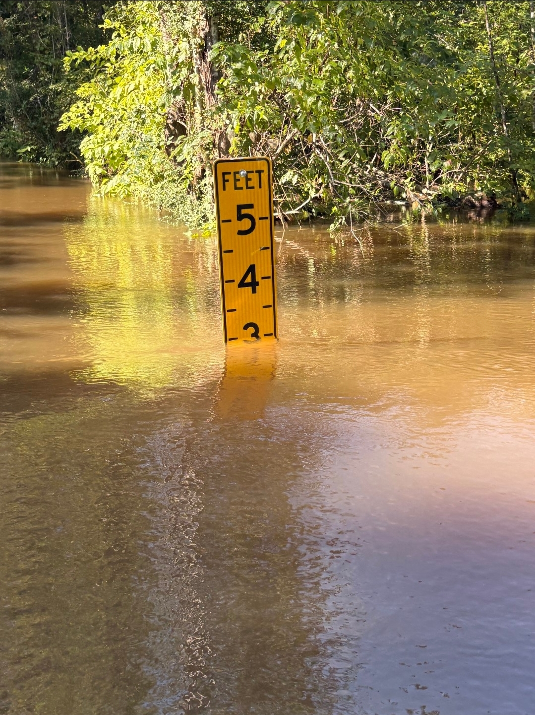
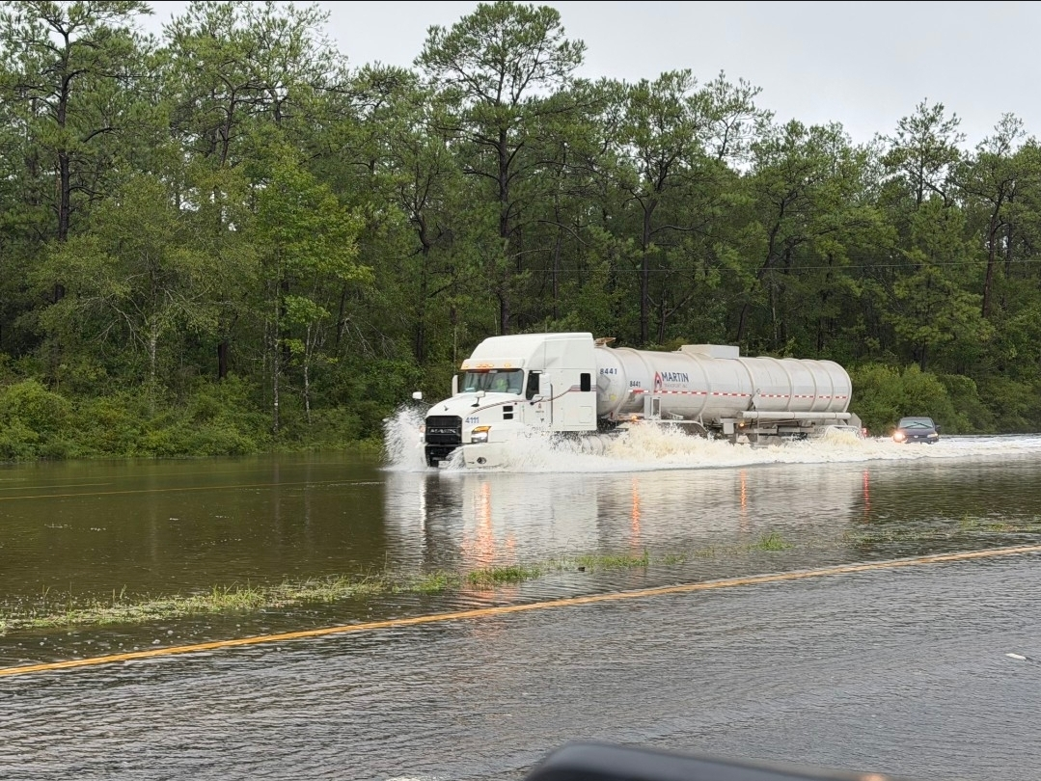
Village Mills/Wildwood

Slide 15
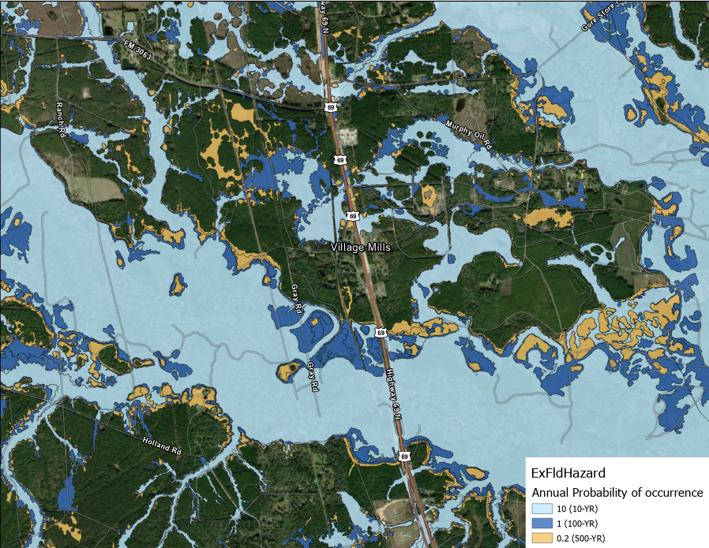
Village Mills/Wildwood (ExFldHazard)

Slide 16
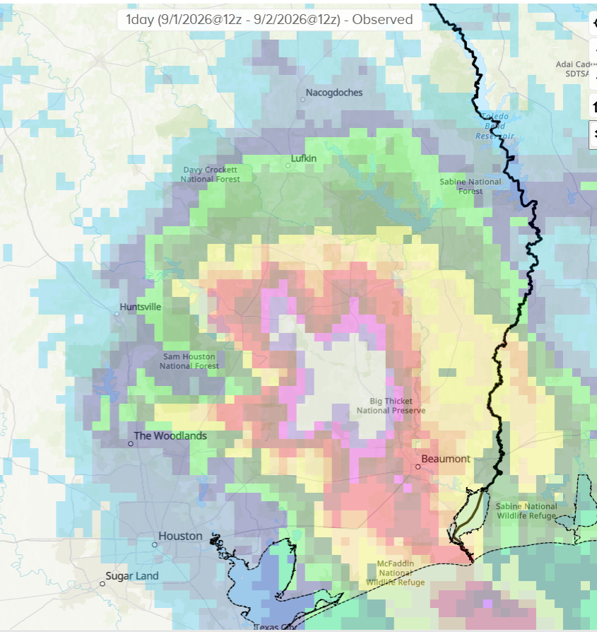
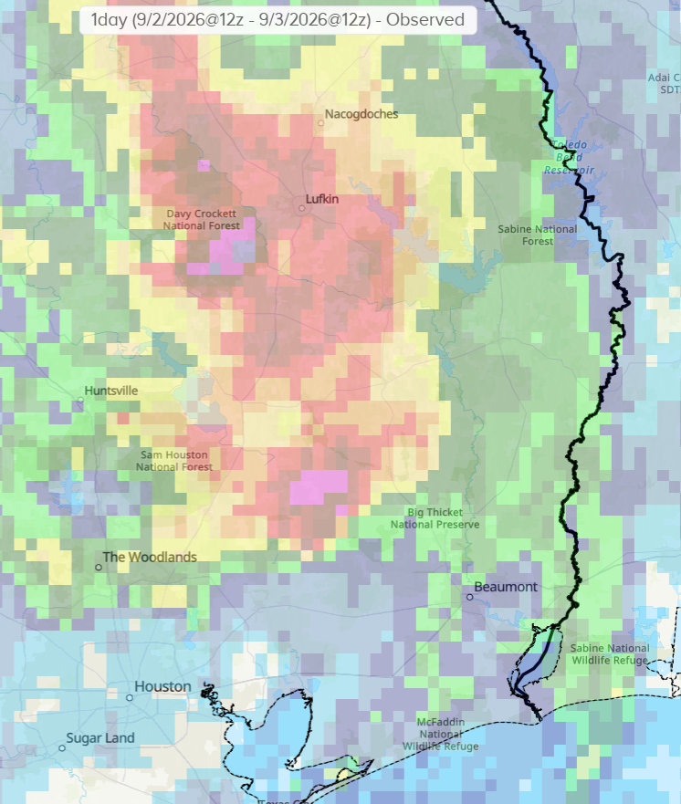
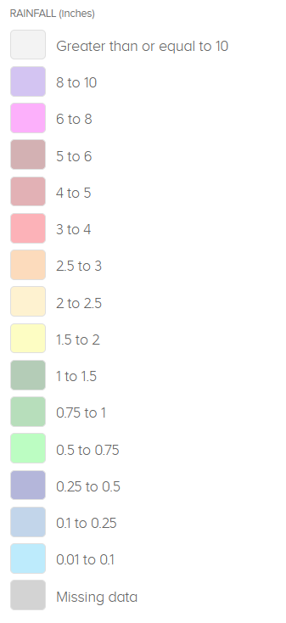
Tropical Storm Edouard
Tue Sept 1st
Wed Sept 2nd

Slide 17
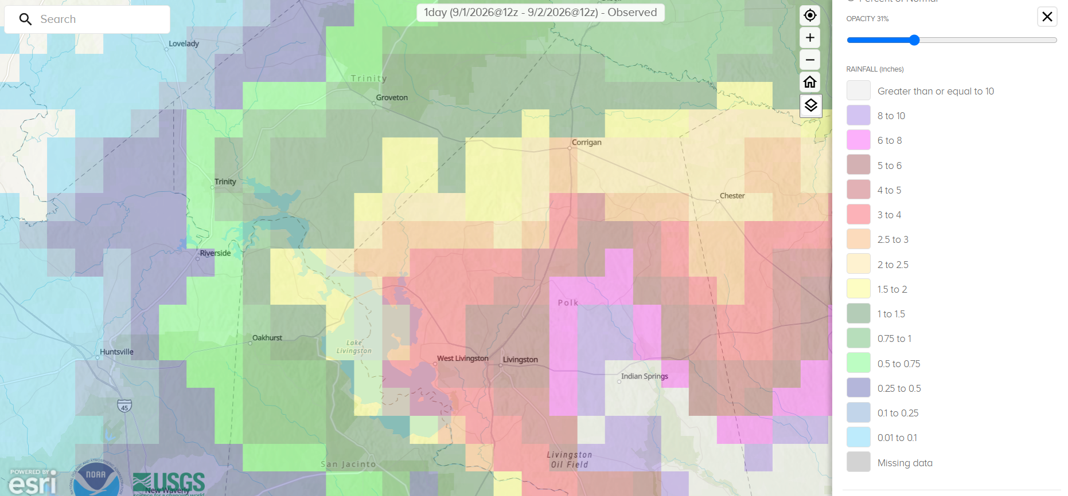
Tropical Storm Edouard
September 1st – 3rd, 2026
  Corrigan received approximately 7.5”
  Indian Springs received approximately 13.0”
Source: NOAA

Slide 18
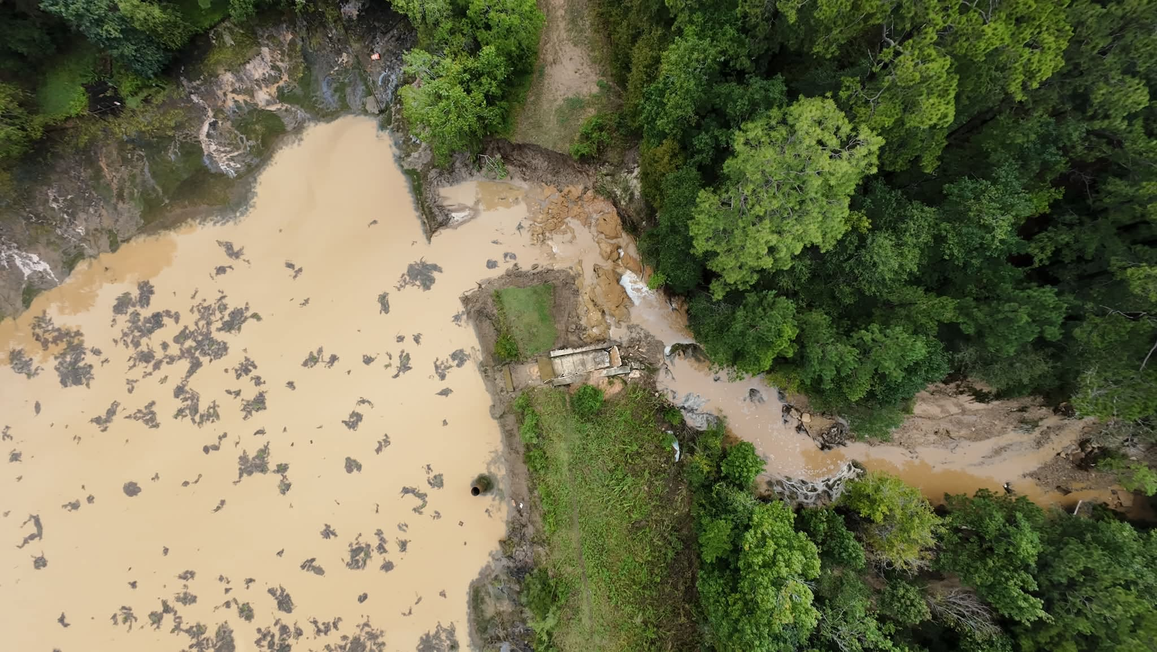
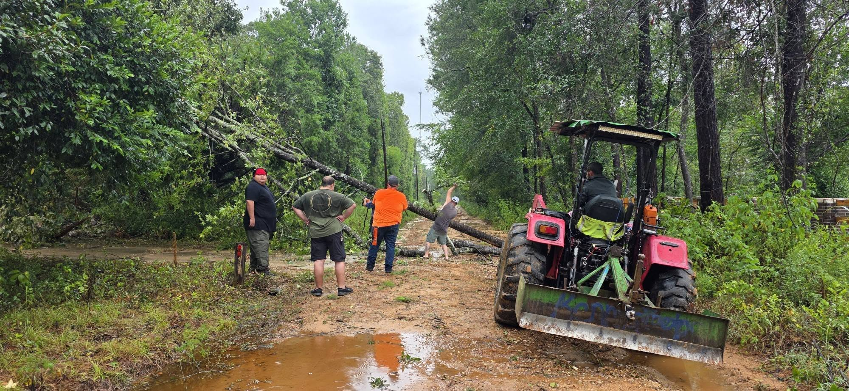
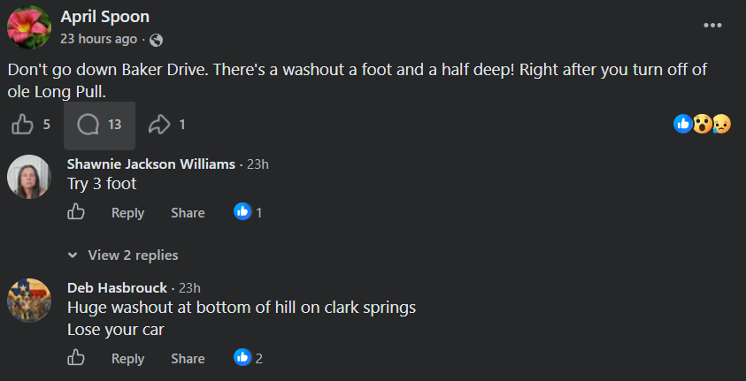
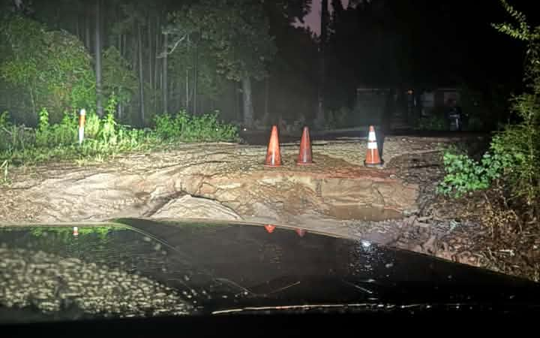
Tropical Storm Edouard
Indian Springs reported damage
  Lake Donna Dam breached
  Residents lost power overnight
  Numerous road washouts
  KPRC2 News Article
Source: Neal Jay, Top Dog FPV Drones, We <3 Indian Springs Facebook page
Source: We <3 Indian Springs Facebook page
Source: We <3 Indian Springs Facebook page

Slide 19
Task 4C – Performance of Flood Management Evaluations

Slide 20
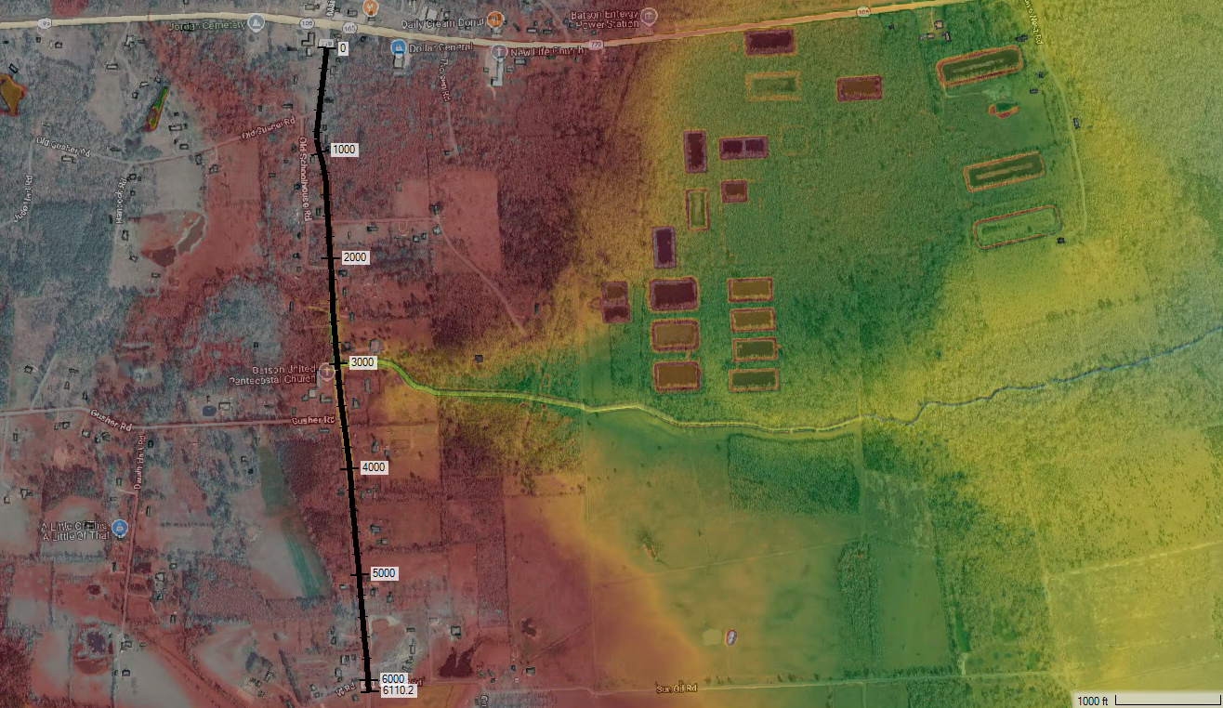
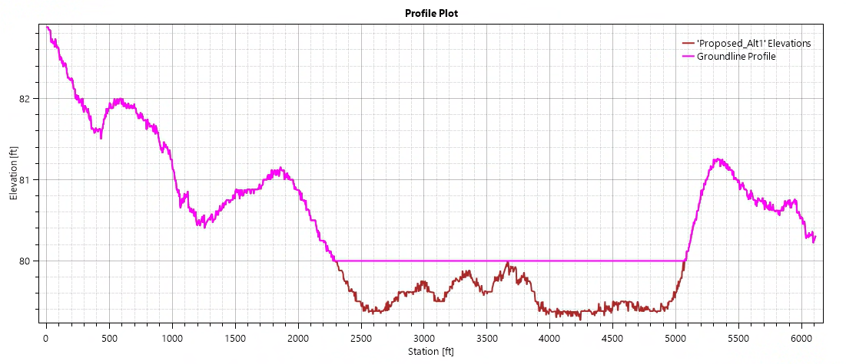
1st Alternative: Road Elevation along FM 770 – Updates
Properties along FM 770 mostly above 100YR WSEL – Opted to elevate roadway to preserve emergency access
30 ft bottom width channel with 3:1 side slopes to aid in mitigating impacts
FM 770 Elevation Stretch– raised to 80 ft from ~ STA 2300 to STA 5100 ft (~0.75 ft increase)

Slide 21
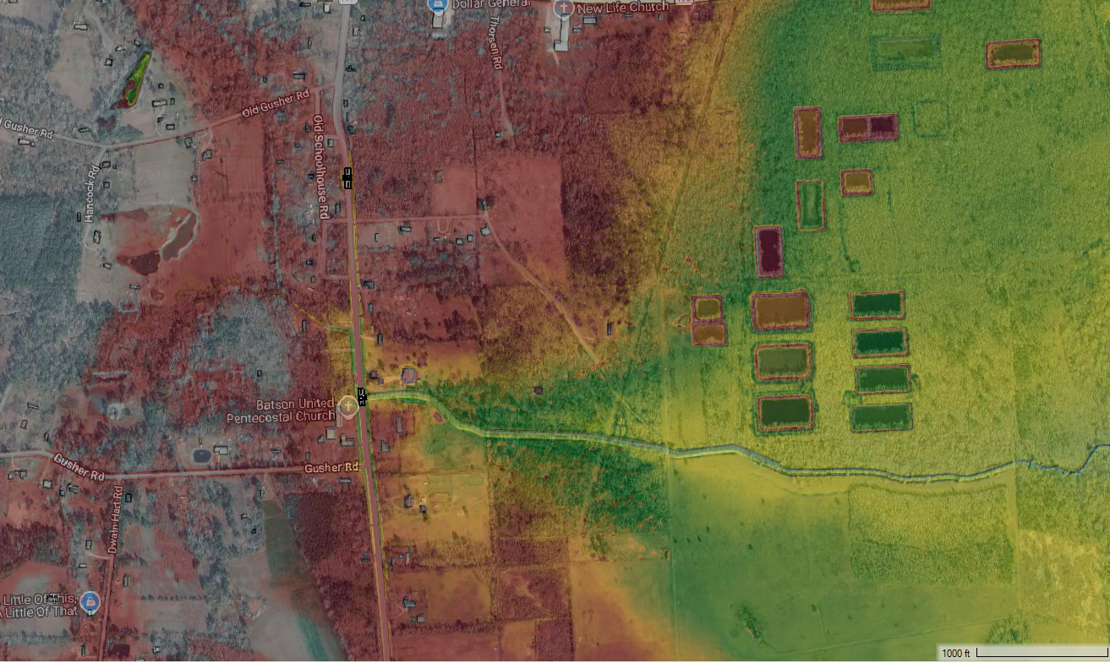

1st Alternative: Road Elevation along FM 770 – Updates
Equalization structure to mitigate ponding to the west
Channel improvement downstream of upgraded crossing
Equalization Structure: 3 – 4’x2’ RCPs
Crossing upgraded to 3 – 8’x4’ RCBs from 3 – 48” RCPs
Channel Improvement DS of Crossing

Slide 22
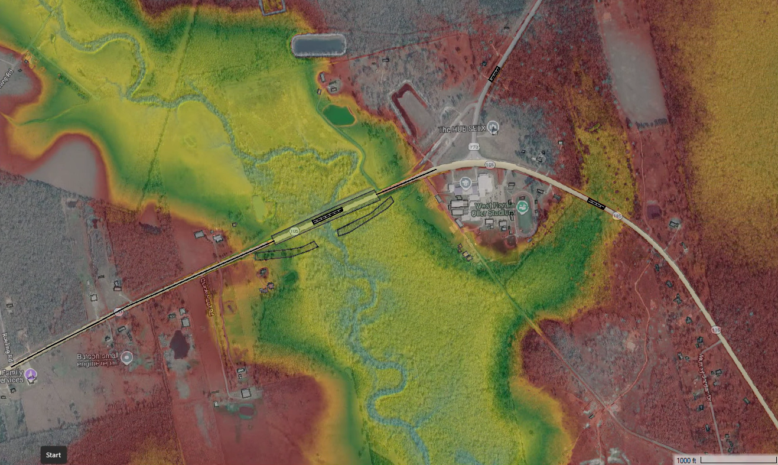
2nd Alternative: Road Elevation along SH 105 + Bridge Crossing Upgrade – Updates
Road elevation along SH 105 to provide emergency access to West Hardin High School
Bridge crossing at Pine Island Bayou to be upsized
SH 105 Elevation Stretch #2 – raised to 69 ft (2 ft increase)
West Hardin High School
Pine Island Bayou
SH 105 Elevation Stretch #1 raised to 70 ft (1.5 ft increase)
Upsized Bridge Extents

Slide 23
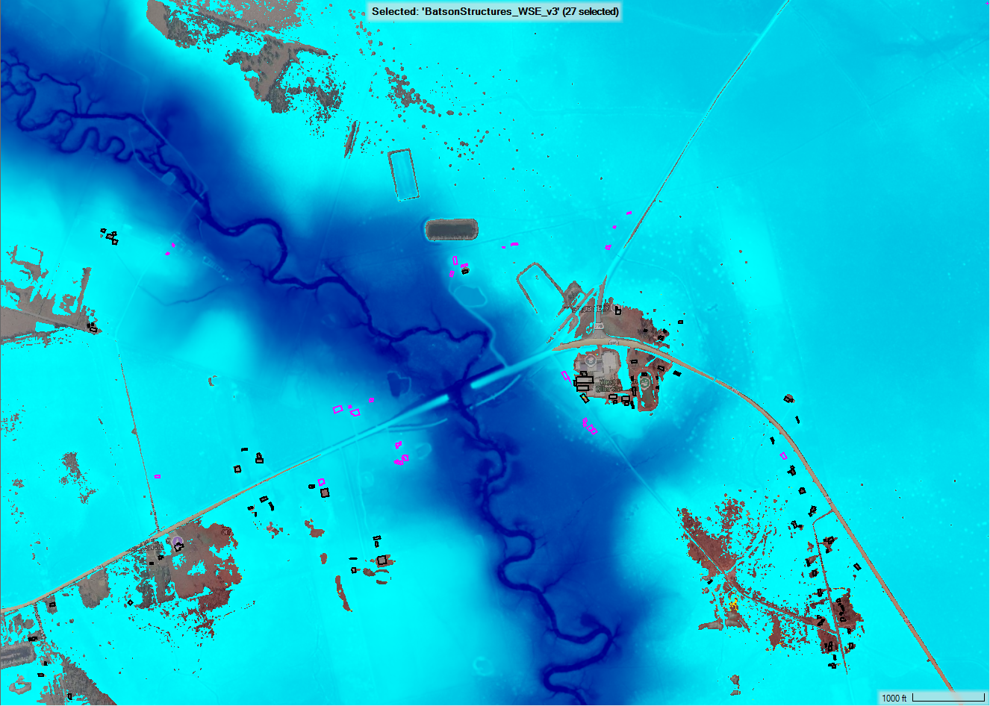
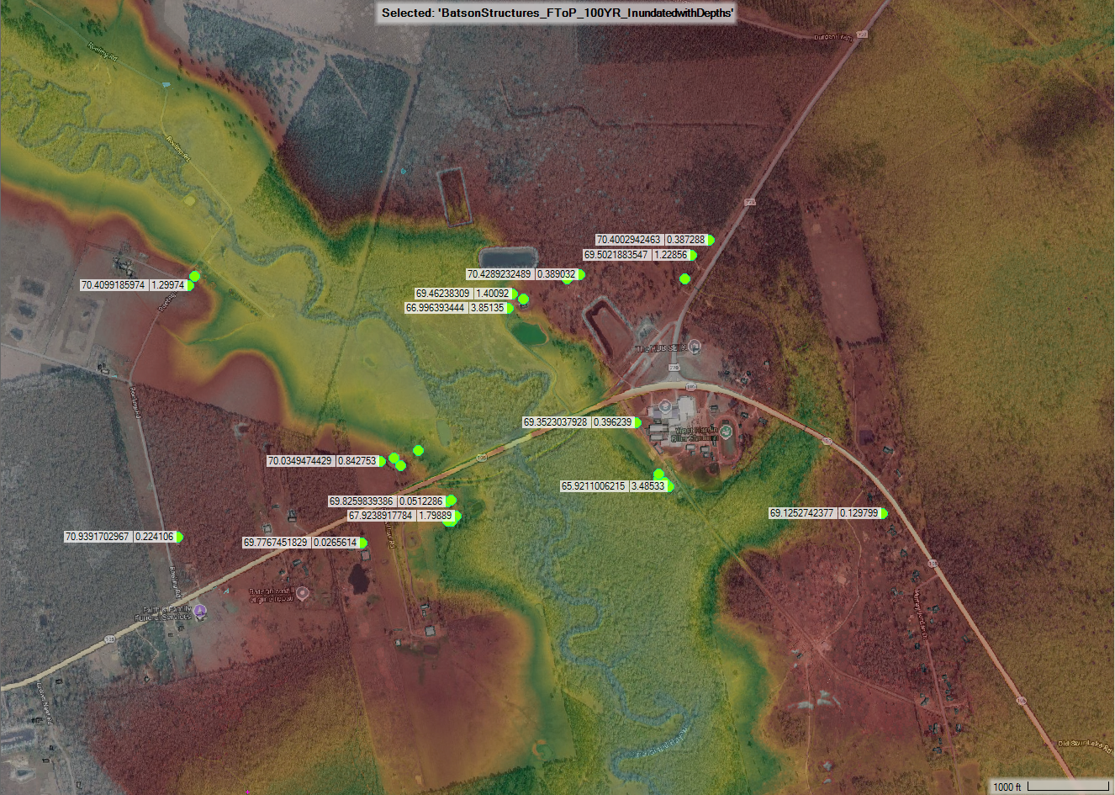
3rd Alternative: Structure Elevation of Properties in Batson
27 properties at 100YR flood risk along SH 105 and FM 770
Structure elevation considered due to proximity to Pine Island Bayou

Slide 24
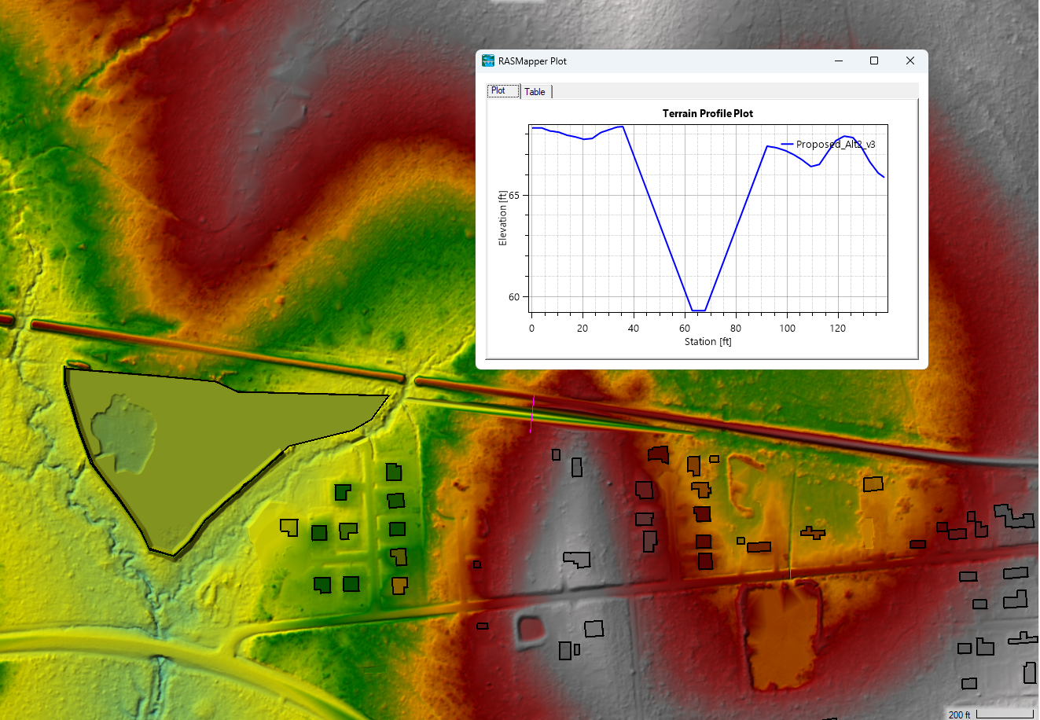
Alternative #1: Channel Diversion for Easy St. Neighborhood
Existing culvert crossing across RR to north causing ponding of neighborhood to south
Channel diversion to westward stream proposed to alleviate flooding for neighborhood
Channel currently 5 ft bottom width with 3:1 side slopes
Preliminary Detention Pond (~20 ac-ft)
Westward Channel Diversion
Railroad
W Deer St.
Easy St.

Slide 25
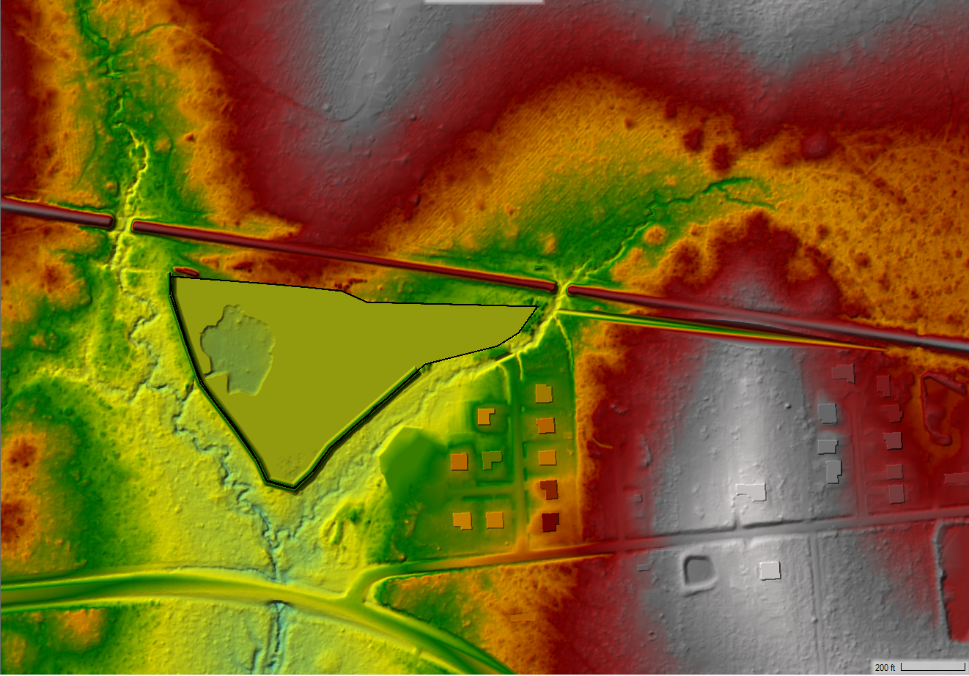
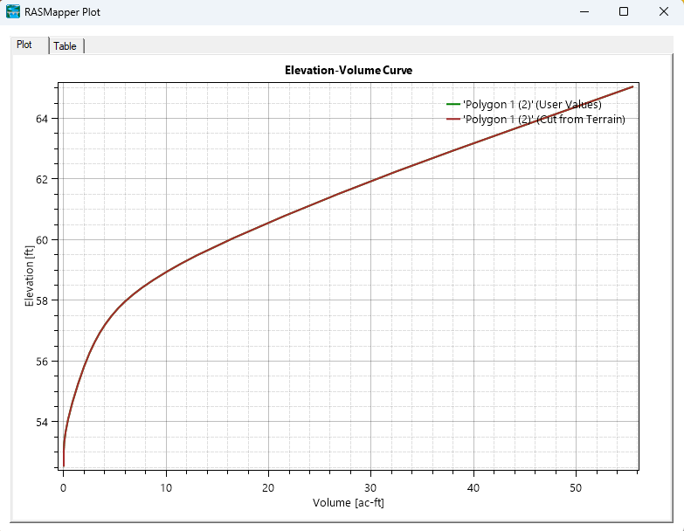
Alternative #1: Channel Diversion for Easy St. Neighborhood
~20 acre-ft of detention is required to fully offset any impact in the 100-YR event
Site of detention will need to be refined in further studies, but proof of concept of capacity was made in the terrain

Slide 26
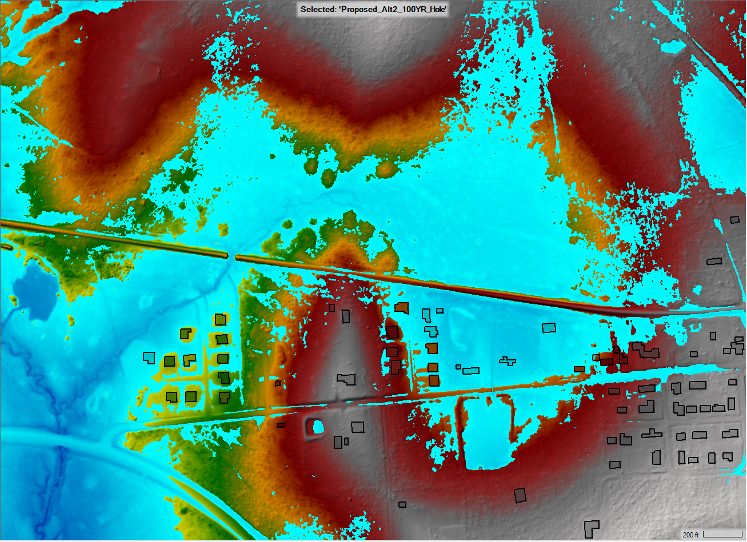
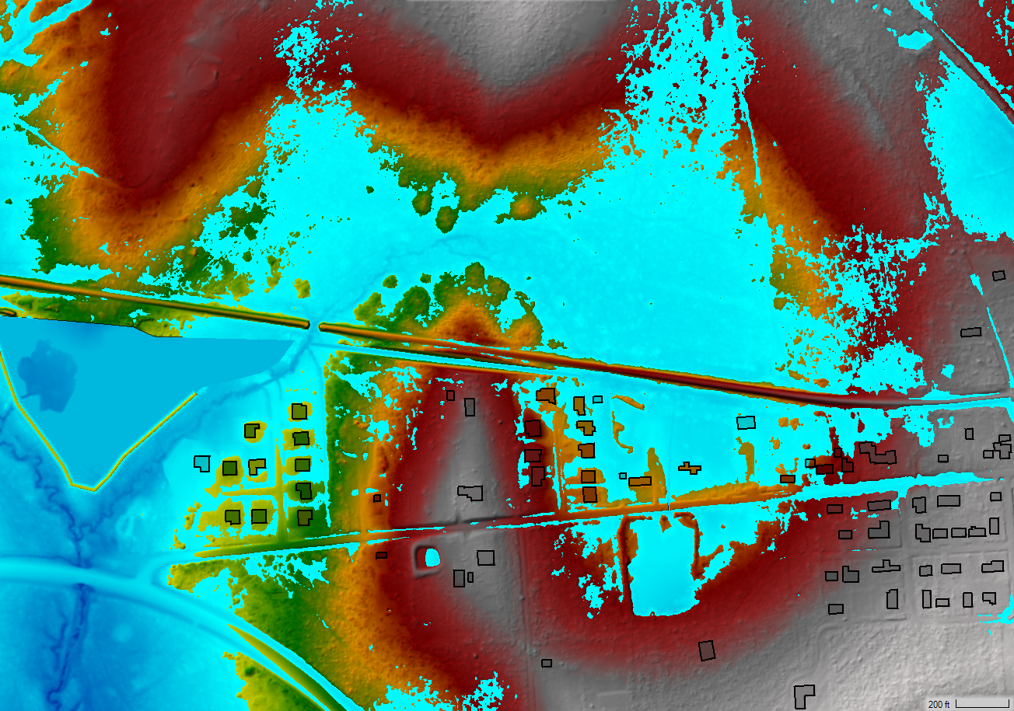
Alternative #1: Channel Diversion for Easy St. Neighborhood
Proposed100YR
Existing100YR

Slide 27
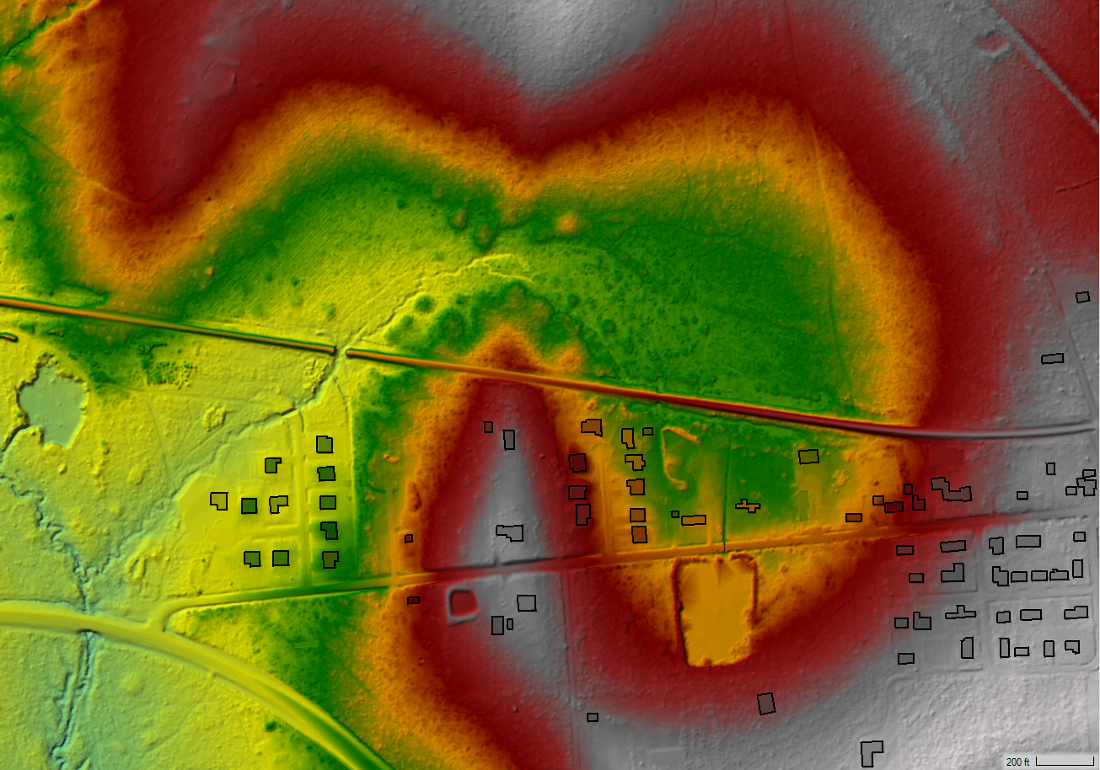
Alternative #1: Channel Diversion for Easy St. Neighborhood
Alternate course of action: install RCP to south to accomplish same objective
Benefit: avoid proximity to RR to north and utilize public Right-of-way to south
Railroad
W Deer St.
48” RCP
Easy St.

Slide 28
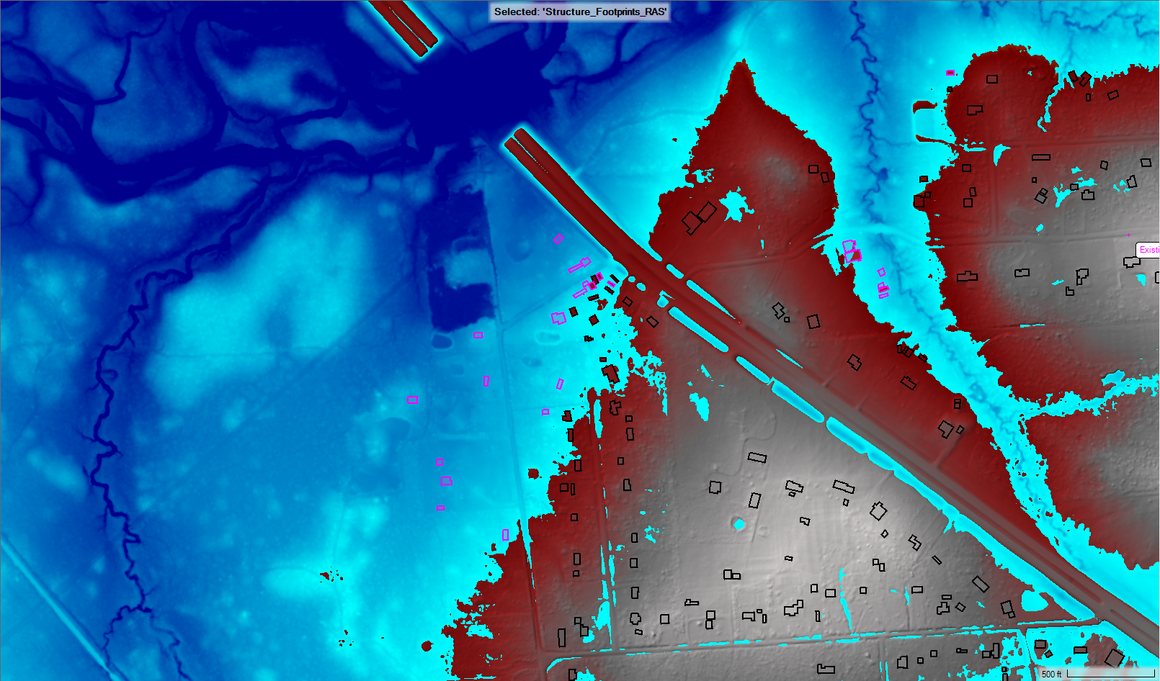
Alternative #2: Structure Elevation along HWY 287 & Overstreet Loop
24 residential properties at 100YR flood risk along Overstreet Loop.
Structure elevation considered due to property locations.

Slide 29
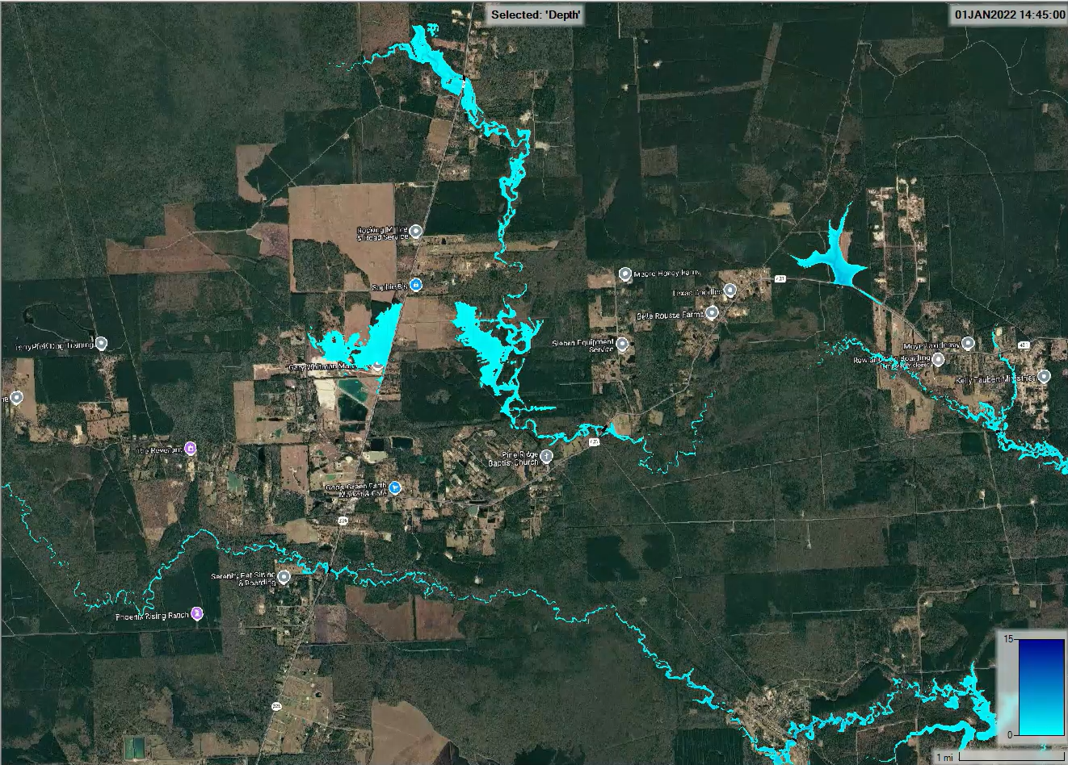
Black Creek Improvements for Pine Ridge
Black Creek
Expansion of existing bridge at FM 421/Black Creek crossing likely necessary to mitigate flows for neighborhood
Whitetail Forest Subdivision
Conduct Channel improvements/widening for ditch to alleviate flooding for neighborhood north of FM 421.
Little Pine Island Bayou

Slide 30
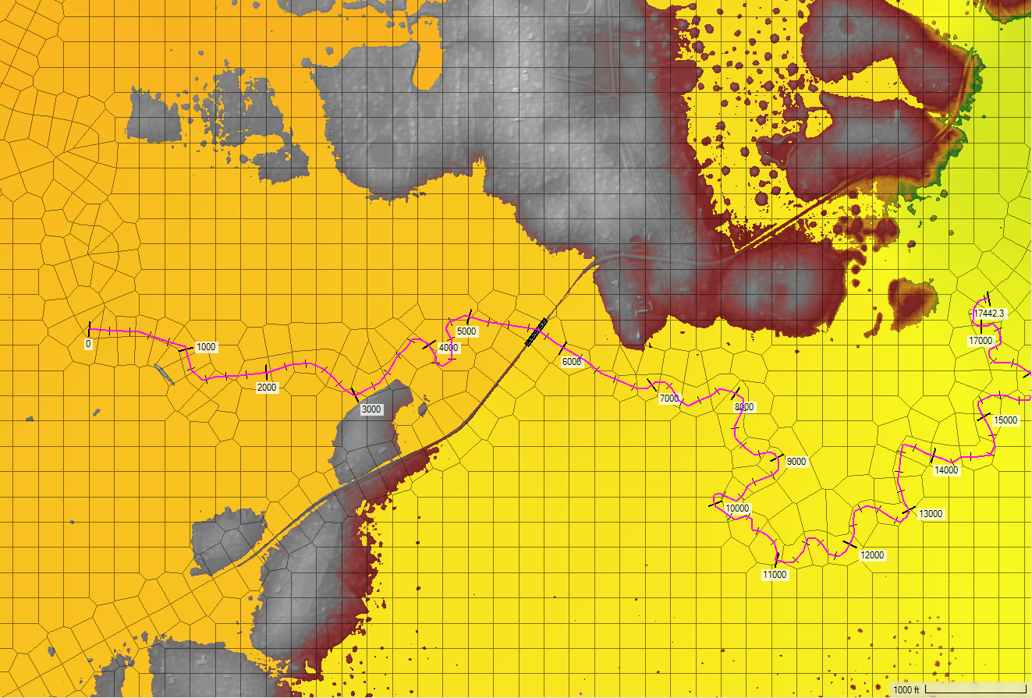
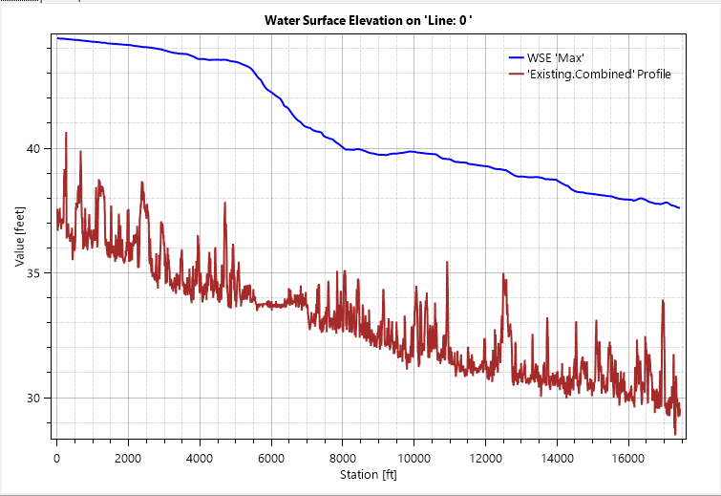
Black Creek Improvements for Pine Ridge – further investigation
A head loss of nearly 4 ft
43.58 ft
39.78 ft
FM 421
Black Creek
FM 421 Crossing

Slide 31
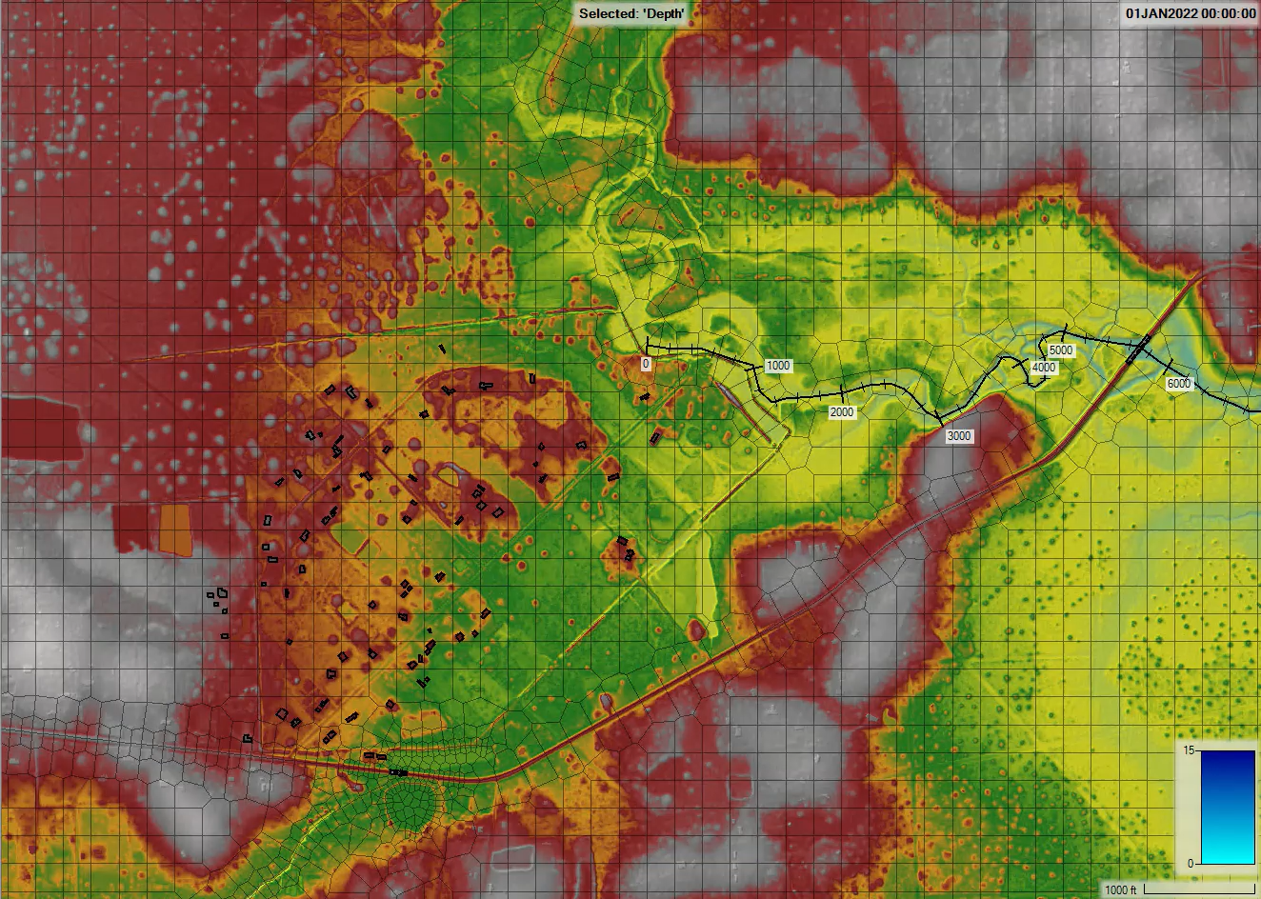
Black Creek Improvements for Pine Ridge – further investigation
Black Creek
FM 421

Slide 32
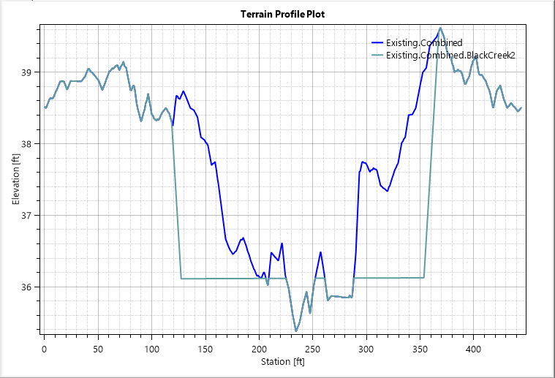

Black Creek Improvements for Pine Ridge – further investigation
Head Loss Counter: Channel widening along Black Creek
  225 ft Width
  4:1 Side Slopes
  ~0.3 ft of benefit for Whitetail Forest properties in 100YR
Project will need to account for impacts via placement of detention
Whitetail Forest Subdivision
Black Creek
FM 421

Slide 33

Black Creek Improvements for Pine Ridge – further investigation
Overflow Counter: Placement of berm to restrict flow from entering Whitetail Forest neighborhood
  Berm has 3:1 side slopes and an elevation of 46.5 ft to keep 100-YR flows from overtopping.
Berm
Top Width : 30 ft
Elevation: 46.5 ft
Black Creek
FM 421
Whitetail Forest Subdivision

Slide 34


Black Creek Improvements for Pine Ridge – further investigation
Proposed100YR
Existing100YR

Slide 35

Further Alternatives – Saratoga Detention/Berm
Place Detention Pond or Install Berm to prevent overflow into PIB
Saratoga
Pine Island Bayou

Slide 36

Further Alternatives – Saratoga Detention/Berm
Previous analysis of Proposed Pond done in 2021
  Preliminary Pond Design was estimated to be 774 ac-ft
    0.96 in benefit for Pinewood Estates residents
    0.48 in benefit for Saratoga residents
  Pond projected to have to increase to capacity of 7,774 ac-ft to provide 1 ft benefit along stream

Slide 37


Slide 38

Polk County – Corrigan
Project Alternatives:
1. Raising Union Springs and improve crossing at US59 on Bear Creek
2. Elevate FM 352 bridge at Dry Creek Tributary
3. Corrigan channel improvements to address flooding along west side of town (W 5th Street, Voss Street, W 3rd Street, W 1st Street, W Front Street)
4. Corrigan-Camden School: homes south of campus are in low lying area, channel improvements
1
2
3
2
1
4

Slide 39

Polk County – Corrigan
Project Alternatives:
1. Raising Union Springs and improve crossing at US59 on Bear Creek
2. Elevate FM 352 bridge at Dry Creek Tributary
3. Corrigan channel improvements to address flooding along west side of town (W 5th Street, Voss Street, W 3rd Street, W 1st Street, W Front Street)
4. Corrigan-Camden School: homes south of campus are in low lying area, channel improvements
1
2
3
3
4
4

Slide 40

Polk County – Reily Village
Project Alternatives:
1. Channel Improvements and Road Improvements at N and S Princess Dr
2. Elevate FM 352 bridge at Ruby Creek
2
FM 352 /
Ruby Creek
1
FM 352
2
Loving Ln / Ruby Creek Tributary
N Princess Dr/
Ruby Creek Tributary
1
N Princess Dr / Ruby Creek
S Princess Dr /
Ruby Creek Tributary
S Princess Dr / Ruby Creek

Slide 41

Polk County – Community of Indian Springs
Project Alternatives:
Low water crossing improvements on Pichetto Trail, Ole Long Pull Road, and Conestoga Trail
Low water crossing improvements / culvert upsizing on Bobcat Trl. and Bobcat Dr.
1
2
2
1

Slide 42

Polk County – Community of Indian Springs
Project Alternatives:
Low water crossing improvements on Ole Long Pull Road and Conestoga Trail
3
3
5
3
3

Slide 43

Polk County – Community of Indian Springs
Project Alternatives:
Low water crossing improvements on Margie Drive and Cherokee Trail
4
4
4

Slide 44

Polk County – Community of Indian Springs
Project Alternatives:
Low water crossing improvements and culvert upsizing on The Ole Don Road and The Ole Barney Road
5
5
5

Slide 45
Task 5A – Recommendation of FMEs, FMSs, and FMPs

Slide 46
FMX Recommendation Process the 2028 RFP
Task 1
Infrastructure Assessment
Task 2
Exposure Analysis
Task 3B
Needs Analysis
Task 3C
Region Goals
Task 4C
Performing FMEs
Task 5B
TWDB Rural FMEs
Task 10
Survey Outreach
Compile Supporting Data
Analysis of New FMXs
2024 SFP FMXs
Confirm Feasibility
Recommend FMXs
Sponsor Outreach

Slide 47
Task 5 - Recommendation of FMEs, FMSs, and FMPs (Cycle 1 Updates)
*FME and FMS Costs updated to 2025 costs due to most being sourced from 2021/2022.
Flood Mitigation Action | Number of Cycle 1 Recommended Actions | Total Flood Mitigation Action Cost | Number of Cycle 1 Recommended Actions (Adjusted) | Total Flood Mitigation Action Cost (Adjusted)
FME | 168 | $94,813,824 | 149 | $102,355,960*
FMS | 157 | $194,596,318 | 157 | $231,354,028*
FMP | 53 | $6,631,098,780 | 52 | $6,648,665,568

Slide 48
Summary of Cycle 1 FMX Updates
FMEs
  19 Cycle 1 FMEs now marked as “Not Recommended”
    Examined under another study like FIF
    Modeling received to promote to FMP
    FME completed and construction underway
FMPs
  1 Cycle 1 FMP now marked as “Not Recommended”
    Orange County Coastal Storm Risk Management Project to be represented in the Sabine RFP
  5 Cycle 1 FMPs now with adjusted costs
    Hillebrandt Bayou FMPs from DD6 Regional Watershed Study
    Bessie Heights Drainage Ditch Extension Project

Slide 49
Task 5 – Recommendation of FMEs, FMSs, and FMPs (Cycle 2 Updates)
New FMEs and FMSs identified from Stakeholder Outreach
New FMPs sourced from Texas General Land Office River Basin Flood Study (Eastern Region)
  Additional FMPs to be included as Task 4C nears completion
Flood Mitigation Action | Number of Cycle 1 Recommended Actions (Adjusted) | New Actions Identified To Date | Total Count To Date
FME | 150 | 126 | 276
FMS | 157 | 45 | 202
FMP | 52 | 11 | 63

Slide 50
Summary of FMPs from GLO East
FMP Name | FMP Description | FMP Cost
Hillebrandt Bayou Structure Elevation | Project elevates buildings for flooding prevention purposes within Hillebrandt Bayou. | $101,500,000
Hillebrandt Bayou Detention Improvements | Construct detention basins within conveyance improvements within Hillebrandt Bayou. | $34,400,000
Spindletop Bayou Channel Widening | The proposed project includes the channel widening of approximately 4.4 miles of Spindletop bayou. The project benefits approximately 30 sq miles of the surrounding area | $205,000,000
Upper Coon/Trotti Creek Detention near Jasper TX | Dam detention project on upper Coon/Trotti Creek to provide upstream flood storage and reduce downstream flood risk within the City of Jasper and lower Sandy Creek watershed | $4,261,210
Levee and local conveyance improvements near SF Taylor Bayou and IH-10 | Levee with local conveyance improvements within Mitigation Area 29 of the GLO RBFS - East Region, located in the community north of the IH-10 and SF Taylor Bayou crossing | $2,857,020

Slide 51
Summary of FMPs from GLO East
FMP Name | FMP Description | FMP Cost
Ayish Bayou & Tributaries Channel Improvement (Desnagging and Clearing) - San Augustine, TX | Approximately 2-miles of Ayish Bayou mainstem and tributaries channel improvement (channel and adjacent floodplain desnagging and clearing) within the City of San Augustine, Texas. | $1,186,800
Tenmile Creek Tributary Detention Basin in Vidor, TX | The proposed 71.26-acre detention basin provides approximately 285 acre-feet of storage at a bottom elevation of 18 feet. It includes a 24-foot-wide berm with 3H:1V side slopes, a 23-foot top elevation, and 22-foot overflow spillways. | $23,046,700
Village Creek Conveyance Improvements – Cypress Creek | Conduct improvements to the main stem of Village Creek in the vicinity of the city of Kountze. | $101,500,000
Rose Hill Acres Levee – Boggy Creek | Detailed modeling, design and construction of levee to benefit the community of Rose Hill Acres | $34,400,000
Home Buyouts in Tyler County/Woodville | Home Buyouts for six residential structures inundated during the 2-year storm event. | $205,000,000
S Beech St Detention Basin & Channel Diversion | Detailed modeling, design and construction of detention basin and diversion channel in Tyler County/Woodville between S Beech St and S Pecan St. | $4,261,210

Slide 52

Cross Regional Coordination
Cross Regional Coordination
  Technical Consultant coordinating with Trinity (R3) and Sabine (R4) to identify duplicate FMXs
  Jurisdiction-wide efforts to be combined to show a complete picture of flood risk exposure, regardless of region boundary

Slide 53
Cross-Regional Coordination
FMX Area | Alteration? | Reason?
Orange Countywide | Defer to Sabine RFPG | Orange County and OCDD remain very active stakeholders within the Sabine RFPG, City of Orange located in Sabine side
Jasper Countywide | Keep | City of Jasper located in Neches region in addition to majority of county
Sabine Countywide | Defer to Sabine RFPG | Majority of county located within Sabine region
Newton Countywide | Defer to Sabine RFPG | Majority of county located within Sabine region
Shelby Countywide | Defer to Sabine RFPG | Majority of county located within Sabine region
San Augustine Countywide | Keep | City of San Augustine located in Neches region in addition to majority of county
Rusk Countywide | Keep | City of Henderson located in Neches region in addition to majority of county
Smith Countywide | Keep | City of Tyler located in Neches region in addition to majority of county

Slide 54
Cross-Regional Coordination
FMX Area | Alteration? | Reason?
City of Vidor | Keep | City of Vidor mostly within Neches region
City of Bridge City | Keep | City of Bridge City mostly within Neches region
Polk Countywide | Defer to Trinity RFPG | Livingston located in Trinity region
Houston Countywide | Defer to Trinity RFPG | Crockett located in Trinity region in addition to majority of county
Henderson Countywide | Defer to Trinity RFPG | Trinity RFPG has contact from stakeholders within the County, majority of Athens located in Trinity side
Liberty Countywide | Defer to Trinity RFPG | Liberty located in Trinity region in addition to majority of county
Trinity Countywide | Defer to Trinity RFPG | Trinity RFPG has contact from stakeholders within the County
Anderson Countywide | Split between Neches and Trinity – any countywide FMXs to have names altered to reflect what region they belong to. | Palestine located directly on region border and both Neches and Trinity have recommended studies be done for the county

Slide 55
Task 7 – Flood Response Information and Activities

Slide 56
Task 7 – Flood Response Information and Activities
Task Goals:
  Summarize nature and types of flood response preparations
Not an analysis related to planning for disaster response or activities
Preparedness
Response
Recovery
Mitigation

Slide 57
Task 7 – Relevant Entities in Region
Local
State
Federal
Police Departments
Fire Departments
County Emergency Responders
Drainage Districts
DPS
TWDB
TDEM
TxDOT
Texas Army National Guard
River Authorities
FEMA
NOAA
USACE
USFS
NWS
USGS

Slide 58
Task 7 – Mitigation
Primary focus of the Regional Flood Planning Process
Implementation of actions, including both structural and non-structural solutions, to reduce flood risk to protect against the loss of life and property
  Examples (Structural):
  Regional Detention
  Storm Drain Improvements
  Low Water Crossing/Bridge Improvements
  Examples (Non-Structural):
  Flood Early Warning Systems
  Floodplain property acquisition
  Elevation of Structures above BFE

Slide 59

Task 7 – Preparedness
5
Actions, aside from mitigation, that are taken before flood events to prepare for flood response activities
Examples:
  Identification of Critical Infrastructure
  Emergency Action Plans
  Public Notification/Education
  Identification of Evacuation Routes
  Tabletop exercises
  Staff training for response/recovery

Slide 60

Task 7 – Response
Actions taken during and in the immediate aftermath of a flood event
Examples:
  Reverse 911 & other notifications
  Social Media Posts/Alerts
  Radio stations & Emergency Alert systems
  Emergency Operation Centers
  Forecast tools & centers
  Closing roadways and traffic control
  Providing high water rescues
  Food & First Aid Distribution
Aerial photo of the Hillebrandt area of Jefferson County immediately after Hurricane Harvey, Beaumont Enterprise

Slide 61

Task 7 – Recovery
Actions taken after a flood event involving repairs or other actions necessary to return to pre-event conditions
Examples:
  Providing information on flood insurance
  Coordinating debris removal and cleanup
  Providing traffic control
  Assisting residents to find temporary housing
  Regular communication with disaster victims
  Coordinating with local businesses
  Compiling and conducting damage assessments

Slide 62
Planning Schedule
October
November
December
Technical Consultant to work on:
  Task 4C – Performance of FMEs
  Task 5A – Recommendation of FMEs, FMSs, and FMPs
Technical Consultant to work on:
  Task 4C – Performance of FMEs
  Task 5A – Recommendation of FMEs, FMSs, and FMPs
  Task 6 – Impacts and contribution of the RFP
RFPG to vote to recommend FMPs
Technical Consultant to work on:
  Task 4C – Performance of FMEs
  Task 5A – Recommendation of FMEs, FMSs, and FMPs
  Task 9 – Flood Infrastructure Financing Analysis
RFPG to vote to recommend FMEs and FMSs

